Slide 1
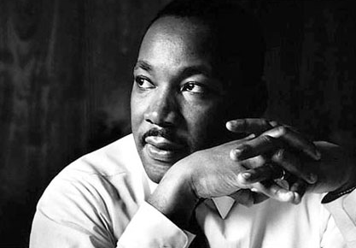
The Reform Movement

Slide 2
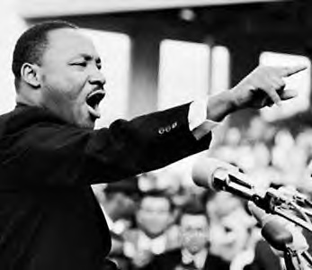
The Reform Movement
A reformer is someone who sees something that they believe is wrong and try to make it right.

Slide 3


Slide 4
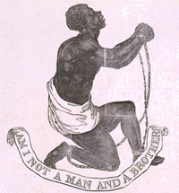
The Reform Movement
Problem:
Slavery
Reform:
Abolitionist – someone who wants to end slavery.

Slide 5
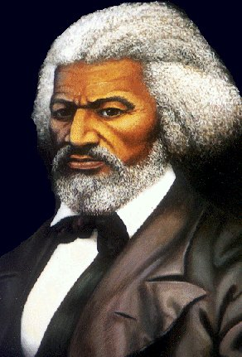
The Reform Movement
Problem:
Slavery
Reformer:
Abolitionist
Fredrick Douglas – former slave who wrote an autobiography and became great speaker.

Slide 6
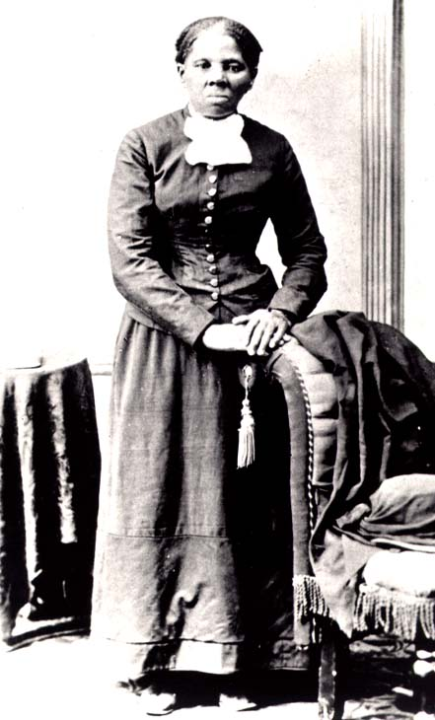
The Reform Movement
Problem:
Slavery
Reformer:
Abolitionist
Harriet Tubman – conductor of the underground railroad leading thousands of slaves to freedom.

Slide 7
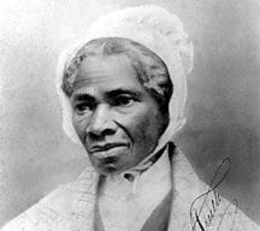
The Reform Movement
Problem:
Slavery
Reformer:
Abolitionist
Sojourner Truth – spoke against slavery, “Ain’t I a woman?”.

Slide 8
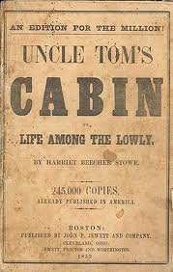
The Reform Movement
Problem:
Slavery
Reformer:
Abolitionist
Harriet Beecher Stowe – wrote Uncle Tom’s Cabin.

Slide 10
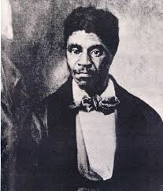
The Reform Movement
Problem:
Slavery
Reformer:
Abolitionist
Dred Scott – Slave who sued for his freedom.

Slide 11
The Reform Movement
Problem:
Slavery
Reform:
13th, 14th and 15th Amendment
Free
Citizens
Vote

Slide 12
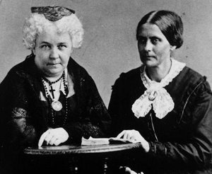
The Reform Movement
Problem:
Discrimination against women
Reformer:
Women’s Rights
Elizabeth Cady Stanton and Susan B. Anthony – help organize the 1st convention at Seneca Falls.

Slide 13
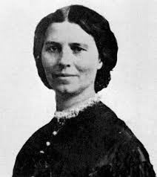
The Reform Movement
Problem:
Discrimination against women
Reformer:
Women’s Rights
Elizabeth Cady Stanton writes, “Declaration of Sentiments”

Slide 14
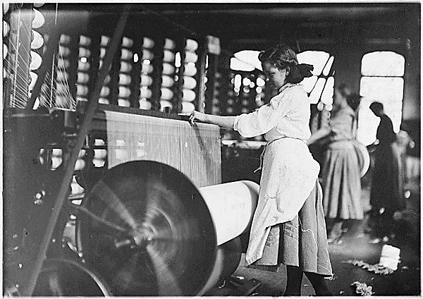
The Reform Movement
Problem:
Discrimination against women
Reformer:
Women’s Rights Achievement:
Work day was shortened for same amount of pay.

Slide 15
The Reform Movement
Problem:
Equal Rights for all people
Reform:
19th Century Rights
Chronology
  1807 - ___________________Banned
  1840 – __________________Speeches
  1848 –________________Convention
  1850’s – _________________ Railroad
  1860 – _______________ elected President
  1870 – __^{th}, __^{th}, and __^{th} Amendments

Slide 16
The Reform Movement
Problem:
Equal Rights for all people
Reform:
19th Century Rights
Chronology
  1807 - Slave Importation Banned
  1840 – Fredrick Douglas Speeches
  1848 – Seneca Falls Convention
  1850’s – Underground Railroad
  1860 – Lincoln elected President
  1870 – 13th, 14th, and 15th Amendments

Slide 17
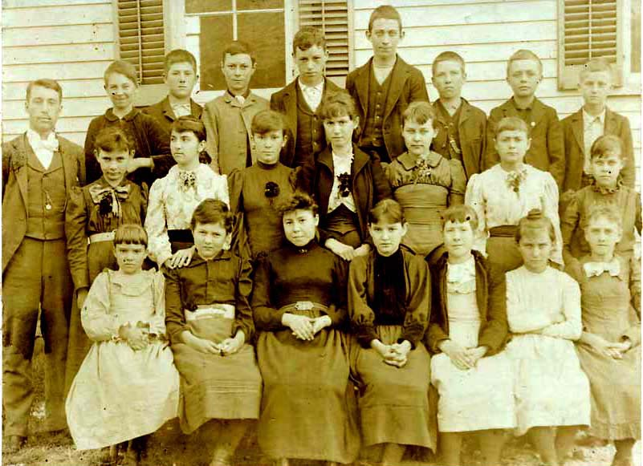
The Reform Movement
Problem:
No schools for the poor.
Reform:
Public Education

Slide 18
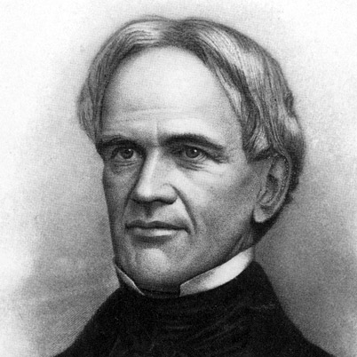
The Reform Movement
Problem:
No school for the poor.
Reformer:
Public Education
Horace Mann – Father of Public Schools.

Slide 19

The Reform Movement
Problem:
Prisoners were mistreated.
Reform:
Prison Reform - Humane treatment and rehabilitation.

Slide 21
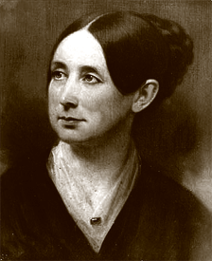
The Reform Movement
Problem:
Prisoners were mistreated.
Reformer:
Dorothea Dix – led the way for humane treatment and rehabilitation.

Slide 22
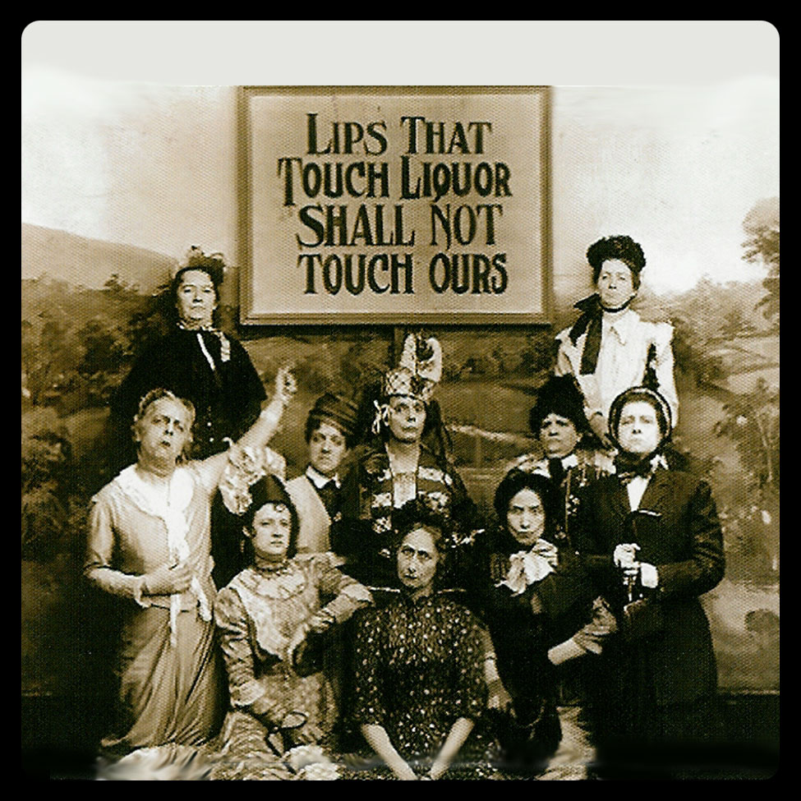
The Reform Movement
Problem:
Alcoholism was destroying families.
Reform:
Temperance- A desire to limit the sale of alcohol.

Slide 23
The Reform Movement
For Reform:
Alcohol + Men = slums, crime, and violence

Slide 24
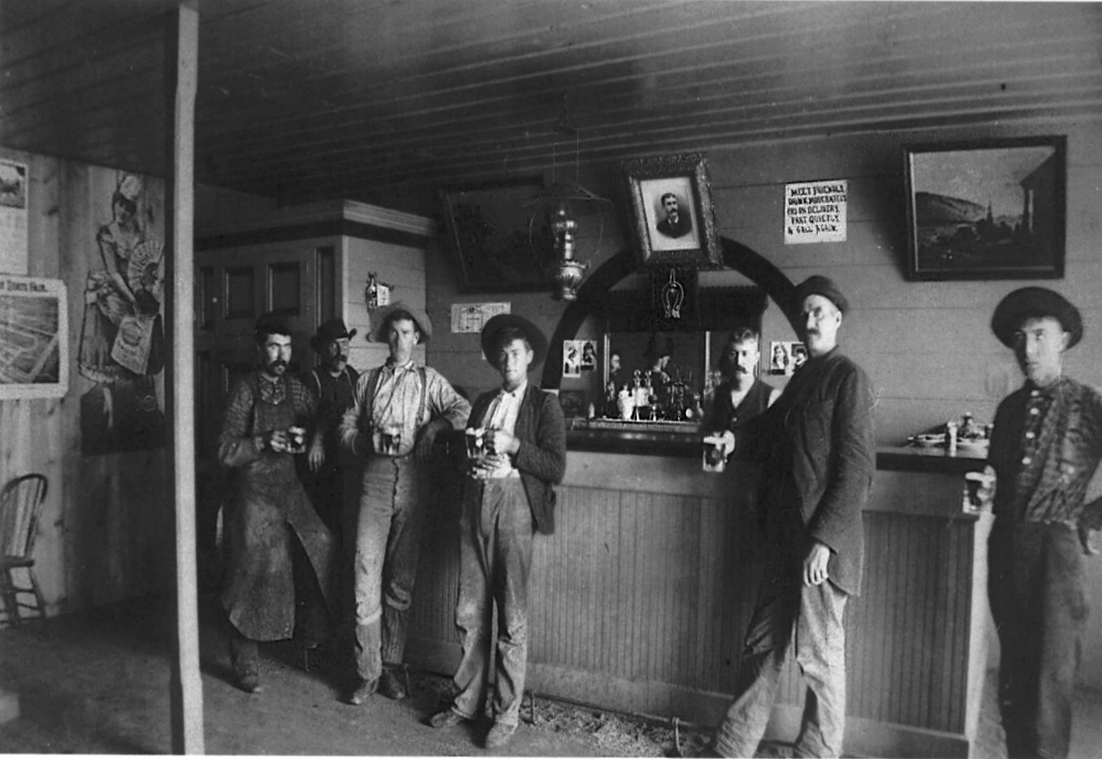
The Reform Movement
Against Reform:
Alcohol + prohibition = job loss and crime.

Slide 25
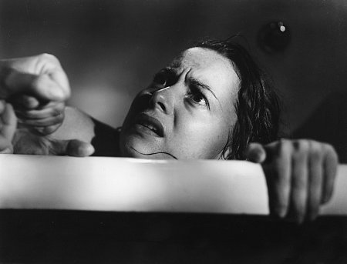
The Reform Movement
Problem:
Mentally ill people were discarded by society.
Reform:
Mental Hospitals- Give them care.

Slide 26
The Reform Movement
Problem:
Mentally ill people were discarded by society.
Reformer:
Dorothea Dix- Led the way for new mental hospitals.

Slide 27
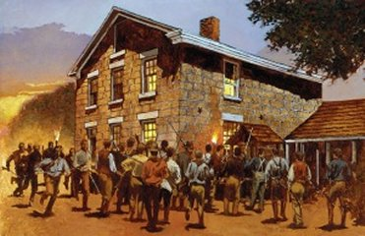
The Reform Movement
Problem:
Persecution of Religion.
Reform:
Move west to a safe location.

Slide 28
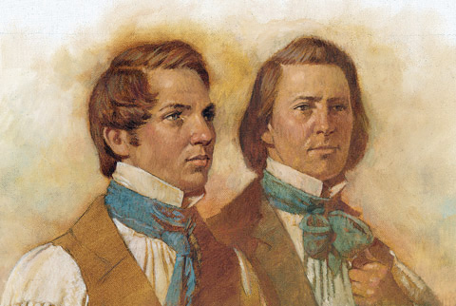
The Reform Movement
Problem:
Persecution of Mormon Church.
Reformers:
Joseph Smith and Brigham Young – led the church members to Utah.

Slide 29
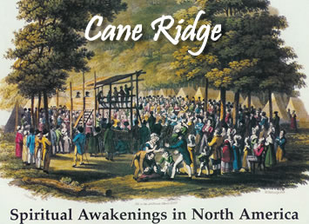
The Reform Movement
Problem:
Rejection of lower class religion.
Reform:
Cane Ridge Revival.

Slide 30

The Reform Movement
Problem: The belief that religion alone limited human achievement.
Reform:
Transcendentalism Human beings can achieve by learning things on their own.

Slide 31
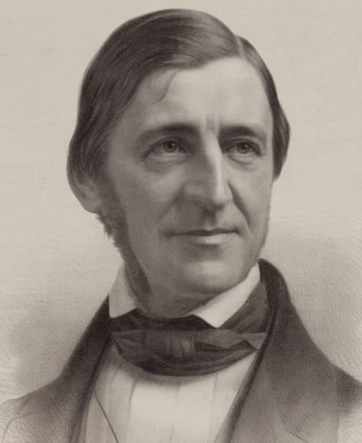
The Reform Movement
Problem:
Religion limits man.
Reformers:
Transcendentalism
Ralph Waldo Emerson – Nature opens your potential.

Slide 32
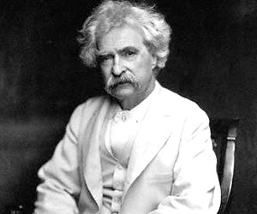
The Reform Movement
Problem:
Religion limits man.
Reformers:
Transcendentalism
Mark Twain – Used uneducated southern culture to show men could learn on their own.

Slide 33
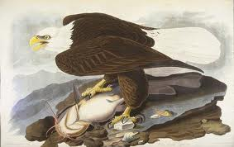
The Reform Movement
Problem:
Religion limits man.
Reformers:
Transcendentalism
James Audubon – Study of birds helps you discover who you are.

Slide 34

The Reform Movement
Problem:
Religion limits man.
Reformers:
Transcendentalism
The Hudson River School artists drew pictures of nature.

Slide 35
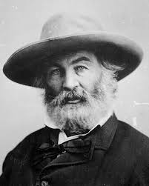
The Reform Movement
Problem:
Religion limits man.
Reformers:
Transcendentalism
Walt Whitman – Author of “Leaves of Grass”

