Slide 1
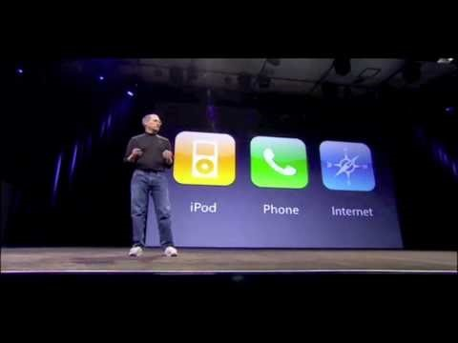

Slide 2
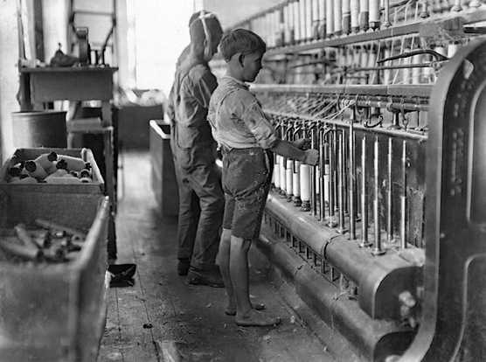
The Industrial Revolution

Slide 3
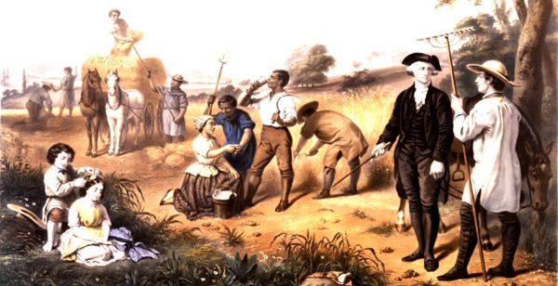
The Industrial Revolution
At the beginning of the 1700’s most people were farmers.

Slide 4
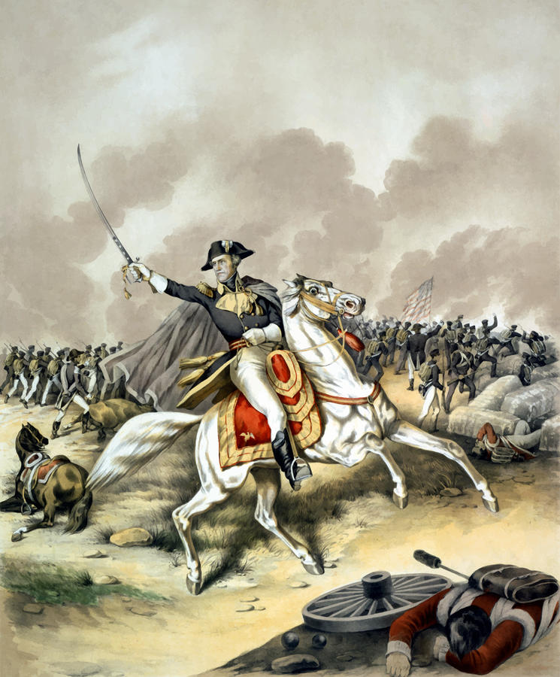
The Industrial Revolution
After the War of 1812 the economy grew quickly.

Slide 5
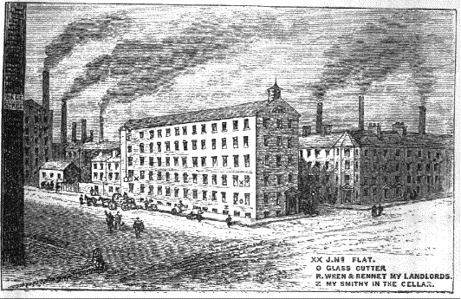
The Industrial Revolution
Factory System + Population shift to cities + Inventions + Immigration = The Industrial Revolution.

Slide 6
The Industrial Revolution
Question
What would be positives and negatives of working in the factory system?

Slide 7
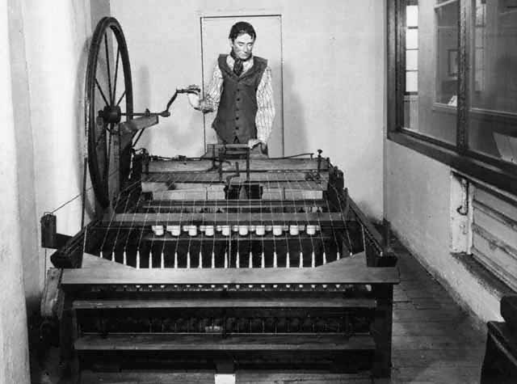
The Industrial Revolution
In England, James Hargreaves invented the Spinning Jenny.

Slide 8


Slide 9
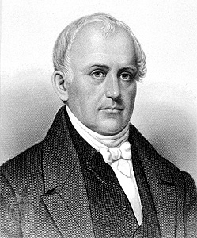
The Industrial Revolution
Samuel Slater came from Europe to share new ideas and built the first textile mill.

Slide 10
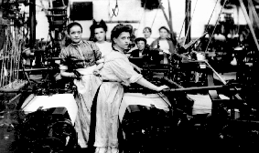
The Industrial Revolution
Women moved from the rural community to the urban community to be by their work.

Slide 11
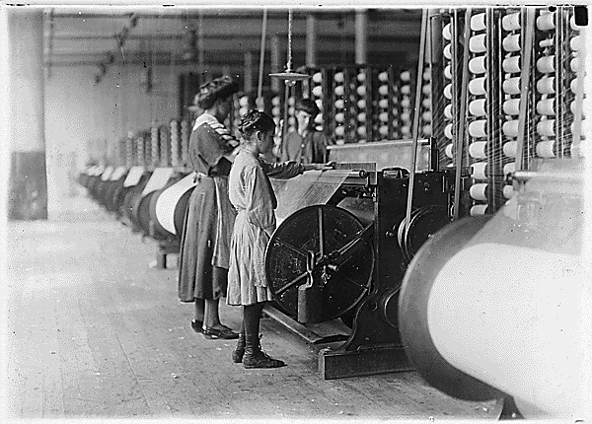
The Industrial Revolution
Francis Cabot Lowell hired young unmarried women, (Lowell Girls) to work in his textile mill.

Slide 12
The Industrial Revolution
Question:
What were the positives and negatives of women and young girls working?

Slide 13
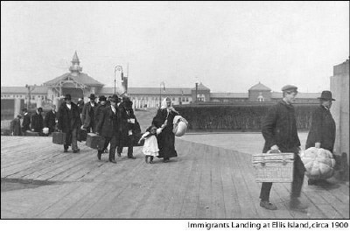
The Industrial Revolution
Immigrants moved from Ireland, England, France and Germany to work in the cities where jobs were available.
PUSH PULL

Slide 14
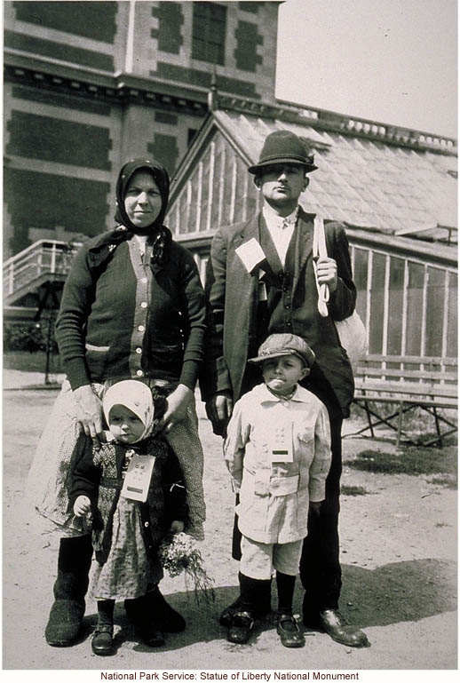
The Industrial Revolution
Men would come first; work, save money, and then send for their families.

Slide 15
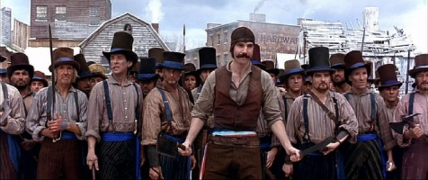
The Industrial Revolution
Immigrant rivalry and violence was common among the different ethnic groups.

Slide 16
The Industrial Revolution
Question:
Why would people moved into a neighborhood with people from their country?

Slide 17
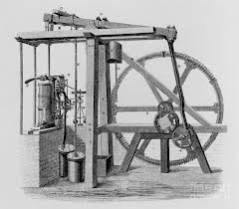
The Industrial Revolution
The birth of the Industrial Revolution began with the invention of the steam engine in 1778.

Slide 19
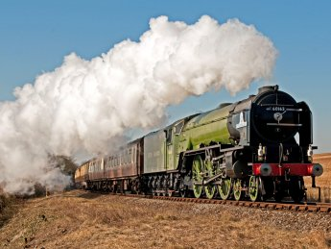
The Industrial Revolution
The steam engine changed the world in both manufacturing and transportation.

Slide 20
The Result Was Pollution

Slide 21
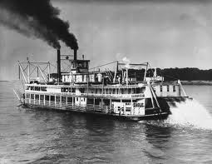
The Industrial Revolution
The Steamboat invented in 1807 by Robert Fulton, allowed products to move quickly up and down the Mississippi River.

Slide 22
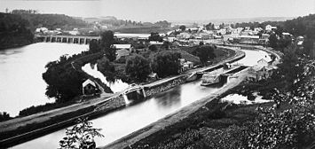
The Industrial Revolution
The completion of the Erie Canal in 1825 allowed products to go from the Atlantic Ocean to the Great Lakes.

Slide 23
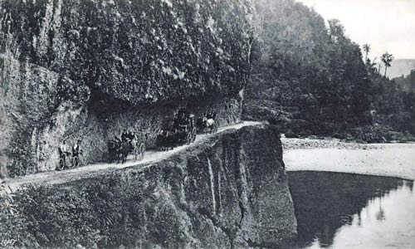
The Industrial Revolution
To open the west to Free Enterprise the United States built roads to travel on.

Slide 24
The Industrial Revolution
Question:
How does transportation lower the cost of buying a product?

Slide 25
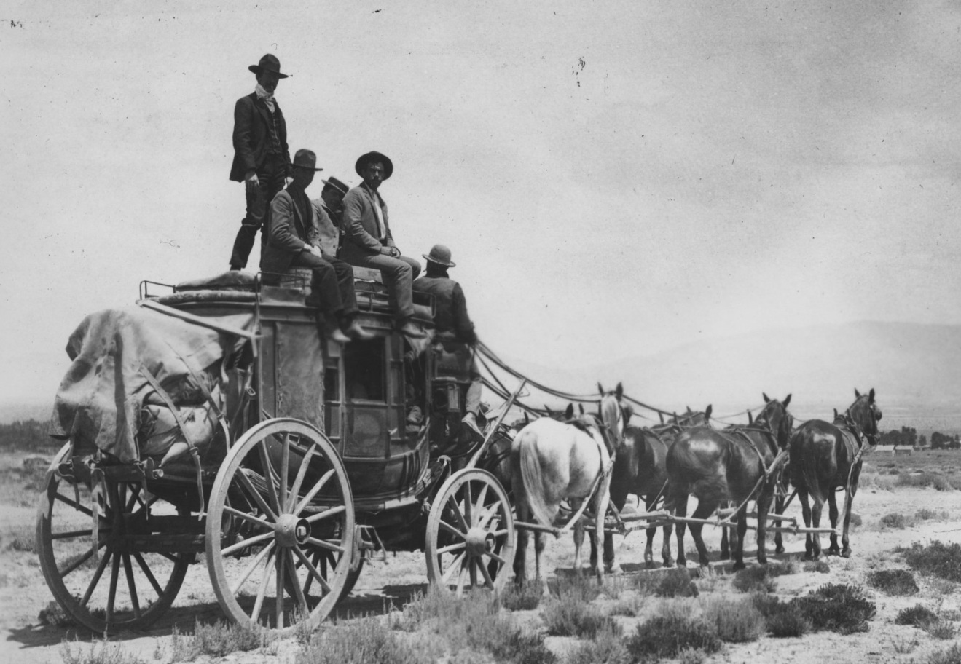
The Industrial Revolution
The wagons and stage coaches provided transportation West during much of the 1800’s.

Slide 26
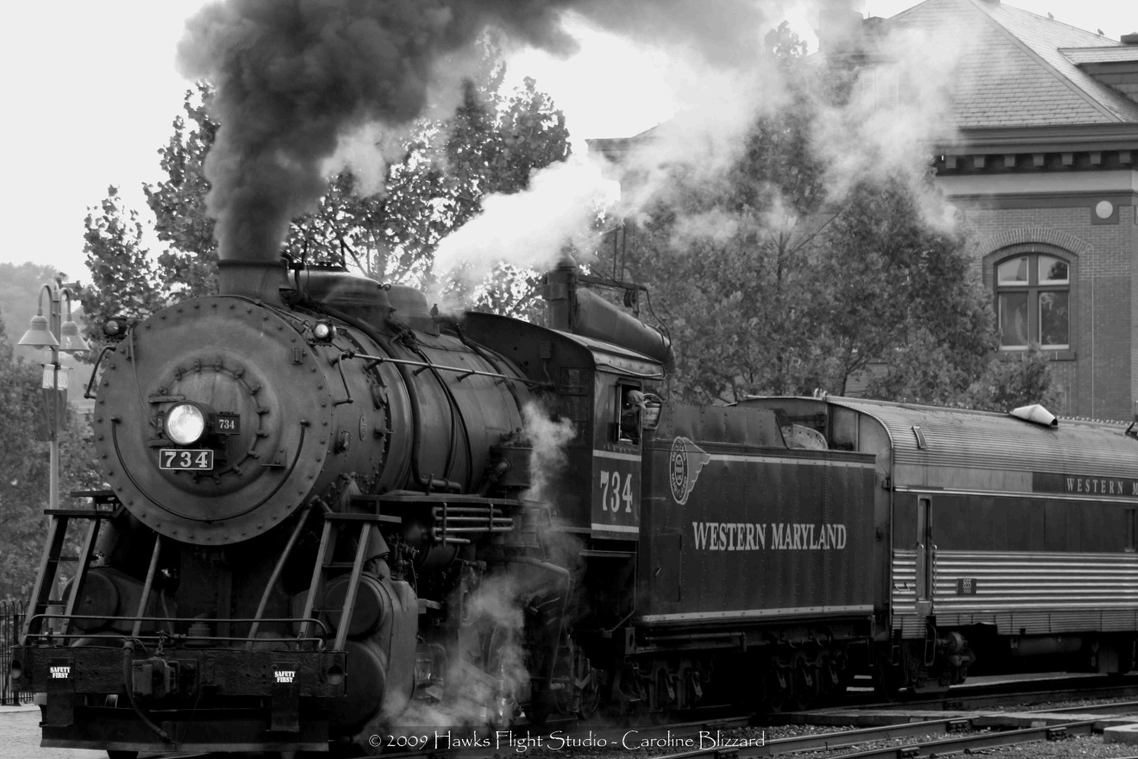
The Industrial Revolution
The Steamboat, Erie Canal, railroads, and stagecoaches also improved communication.

Slide 27
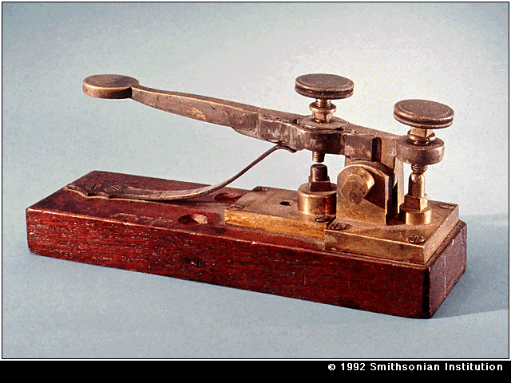
The Industrial Revolution
In 1844 Samuel Morse invented the telegraph. It changed communication forever.

Slide 28
The Industrial Revolution
Discussion:
List as many benefits as you can for having quick or instant communication.
Stop

Slide 29
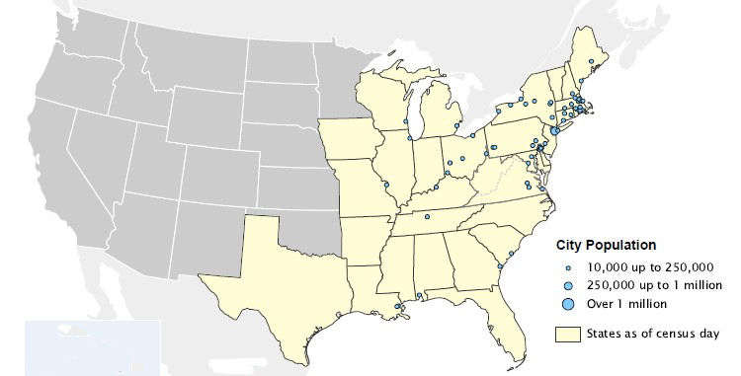
The Industrial Revolution
Population Density
East Coast & Midwest – Very Dense
South – Middle Density
West – Light Density

Slide 30
The Industrial Revolution
Discussion:
List one benefit and one negative for living in each section of the country.

Slide 31
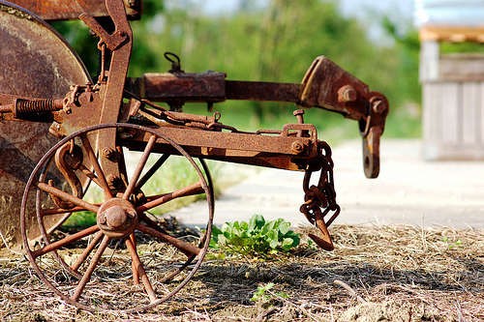
The Industrial Revolution
There was an increased need for farming and agriculture.

Slide 32

The Industrial Revolution
The south had thousands of acres of rich, fertile land that was ideal for growing crops.

Slide 33
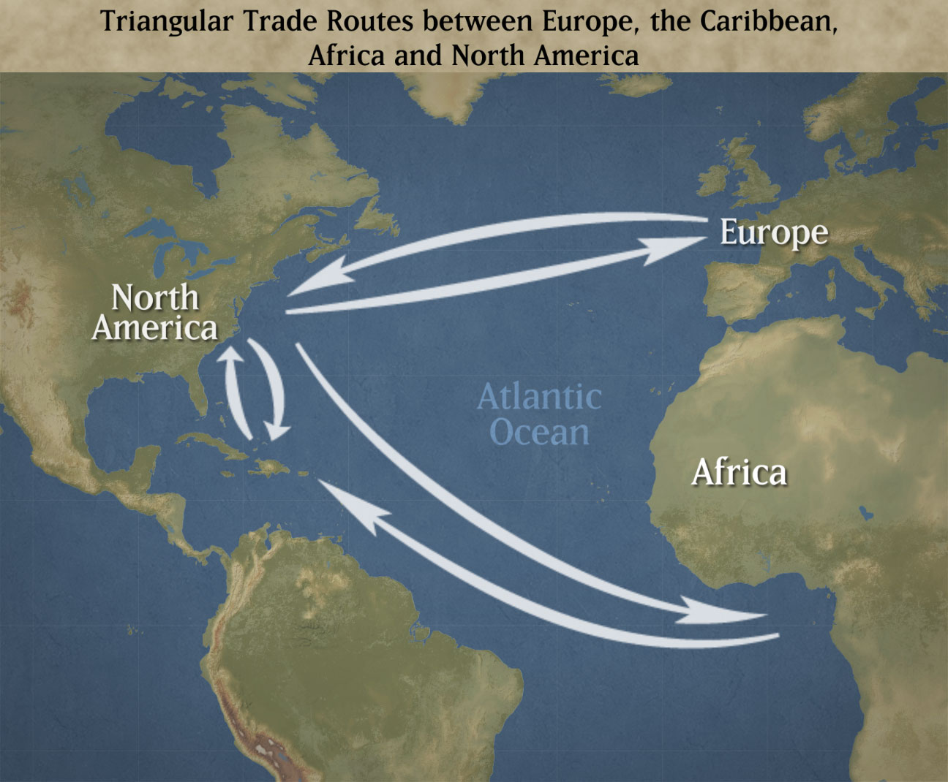
The Industrial Revolution
Triangular Trade had brought thousands of slaves to America up until 1807.

Slide 34
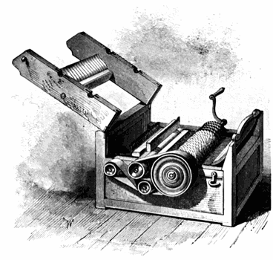
The Industrial Revolution
Eli Whitney invented the Cotton Gin in 1794 and the cotton plantations grew rapidly.

Slide 36
The Industrial Revolution
Question
You invent the cotton gin. What are the positives and negatives of you selling this to plantation owners?

Slide 37
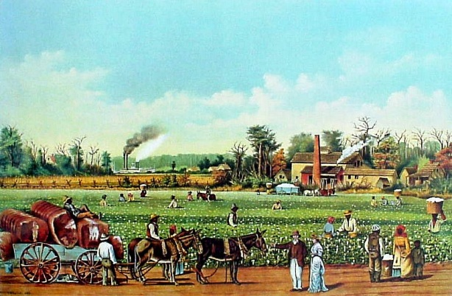
The Industrial Revolution
Plantation System
Rich soil
Tri-Trade
Cotton Gin
Southern Wealth

Slide 38
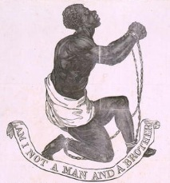
The Industrial Revolution
Scientific discoveries >
Applications > Immigration >
Slavery

Slide 39
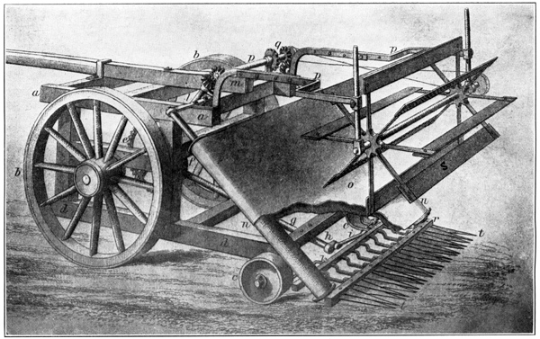
The Industrial Revolution
In 1834 Cyrus McCormick invented the Mechanical Reaper.

Slide 40
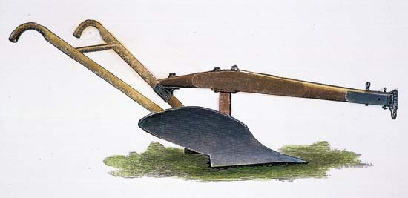
The Industrial Revolution
In 1837 John Deere invented the steel plow which advanced farming.

Slide 41
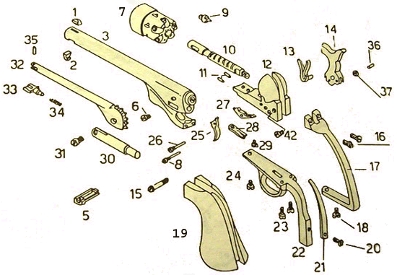
The Industrial Revolution
Eli Whitney’s use of interchange-able parts allows.

Slide 42

The Industrial Revolution
The embargo during the War of 1812 actually helped America learn to make products on their own and expanded manufacturing.

Slide 43
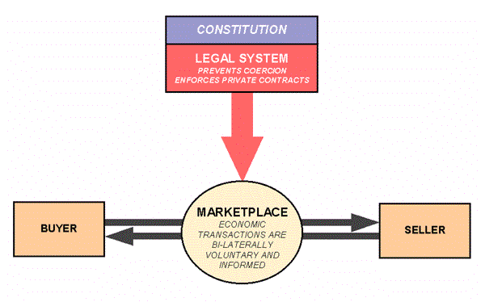
The Industrial Revolution
The Free Enterprise System
Work Hard
Make a Product
Sell it for a Profit
Find ways to make it cheaper
Increase Profit

Slide 44
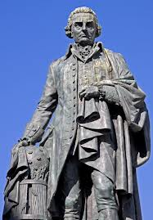
The Industrial Revolution
Adam Smith believe that when the government gets involved in business the economic growth of America will slow down.

Slide 45
Affordable Care Act
Cost of a family of 4 increased 53% more than it would have.

Slide 46
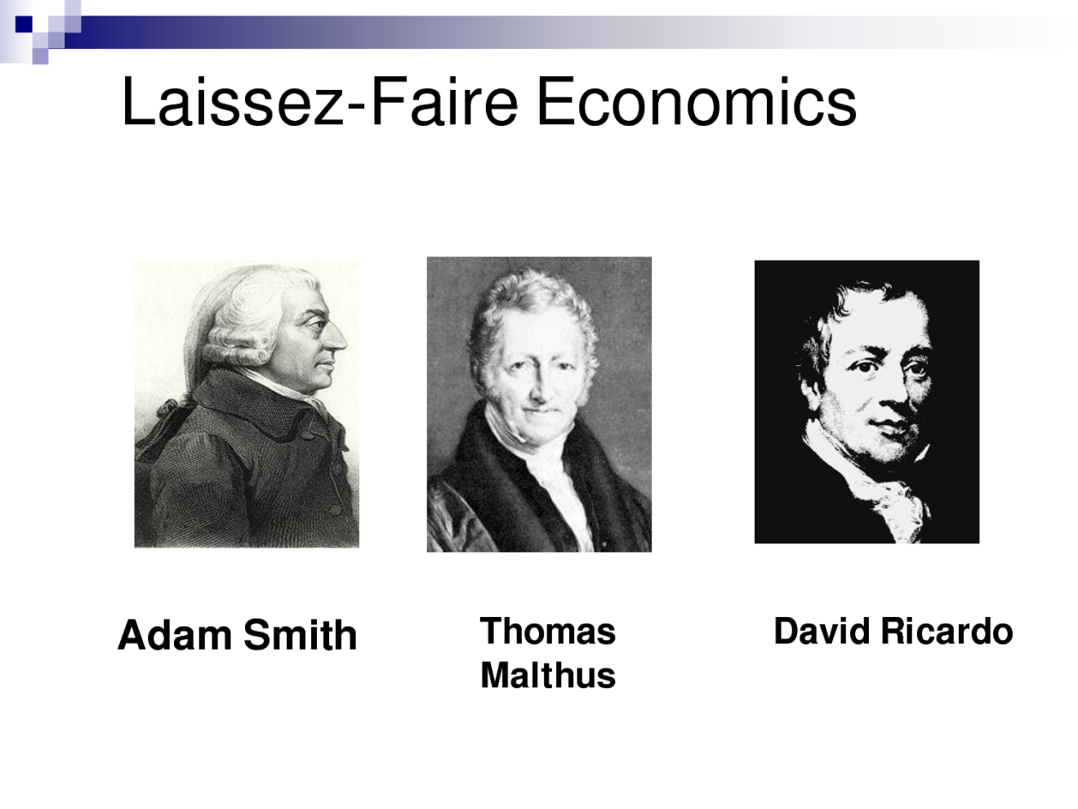
The Industrial Revolution
Laissez-faire economics states that government should have minimal involvement (peace and property rights).

Slide 47
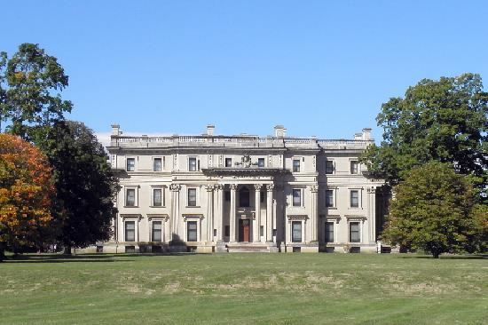
The Industrial Revolution
Growing community > Natural Resources > Investment Capitol > Transportation >
Thriving Business

