Slide 1
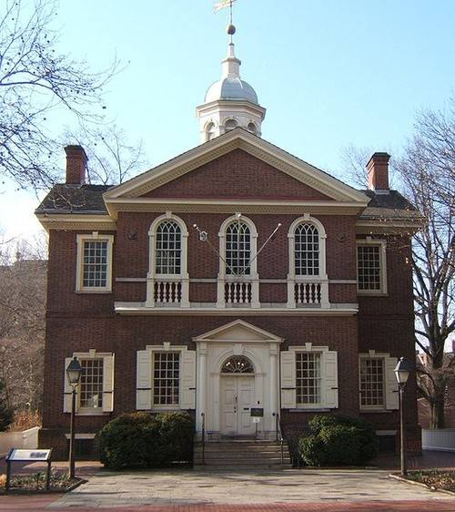
Second Continental Congress
Second Continental
Congress Began :
May 10, 1775
Carpenter Hall
Philadelphia, PA

Slide 2
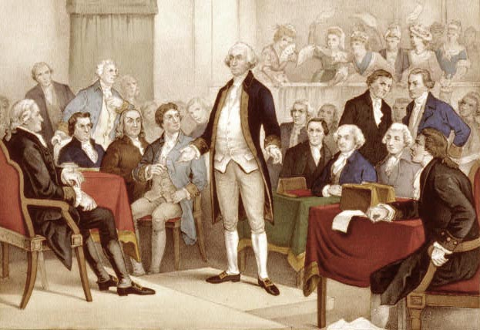
Second Continental Congress
Second Continental Congress included :
New attendees included Ben Franklin and Thomas Jefferson.

Slide 3
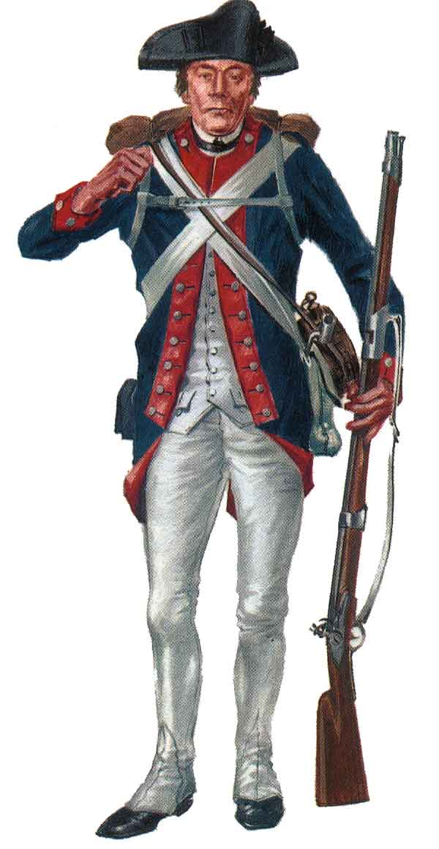
Second Continental Congress
These delegates voted to organize the Continental Army.

Slide 4
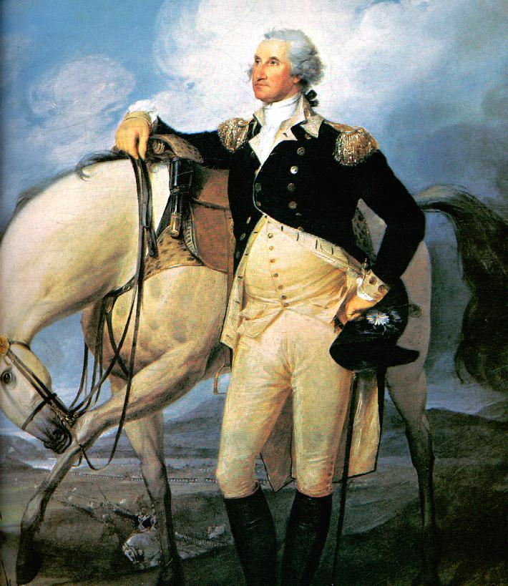
Second Continental Congress
George Washington was appointed Commander-in-Chief of the Continental Army.

Slide 5

Second Continental Congress
A final plea for peace was sent to King George at the request of the Loyalists. It was called the “Olive Branch Petition”.

Slide 6
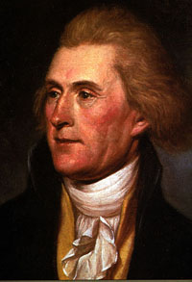
Second Continental Congress
A committee, led by Thomas Jefferson was asked to draft a Declaration of Independence.

Slide 7
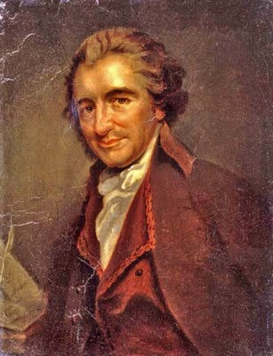
Second Continental Congress
An influential writer, Thomas Paine, wrote a pamphlet, Common Sense. This booklet helped recruit colonists to the cause for freedom.

Slide 8
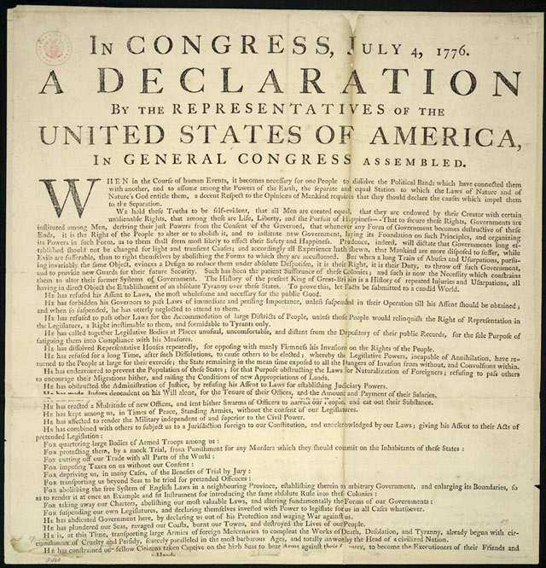
Second Continental Congress
The Declaration of Independence was adopted into law on July 4, 1776.

Slide 9
Second Continental Congress
“All men are created equal and endowed by their creator with certain unalienable rights, that among these are life, liberty and the pursuit of happiness.”.

Slide 10
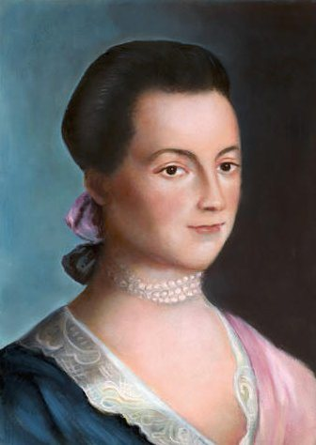
Second Continental Congress
Abigail Adams, wife of John Adams, made sure that he “remembered the rights of women”.

Slide 11
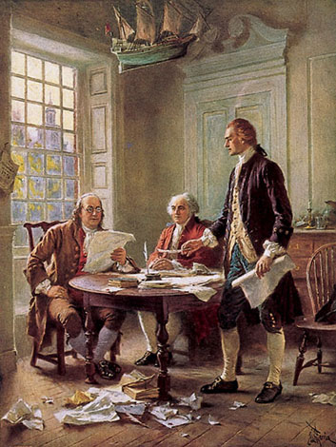
Second Continental Congress
Ben Franklin was appointed to try and convince the French to send troops to support the Revolution.

Slide 12
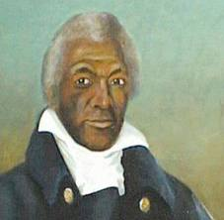
The Revolutionary War
James Armistead was a slave who became a servant for the British but was really a Patriot spy.

Slide 13
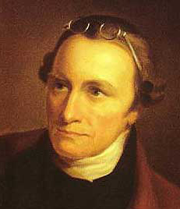
The Revolutionary War
Patrick Henry, a member of the House of Burgesses, stated, “Give me liberty or give me death!”

Slide 14
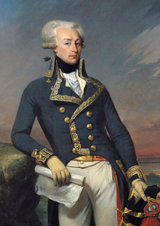
The Revolutionary War
Marquis de Lafayette was a young French aristocrat who came to America to help Patriots win their liberty.

Slide 15
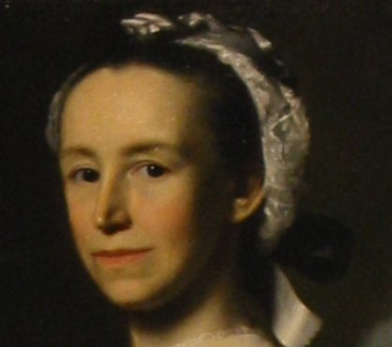
The Revolutionary War
Mercy Otis Warren used her writings and plays as propaganda to criticize the British government.

Slide 16
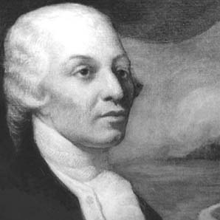
The Revolutionary War
Haym Salomon was a Polish born, Jewish immigrant who raised money for the Revolution.

Slide 17
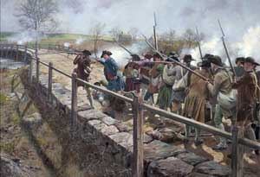
The Revolutionary War
Three Key Battles of the American Revolution:
The first battle…
Lexington and Concord, took place in April of 1775.

Slide 18
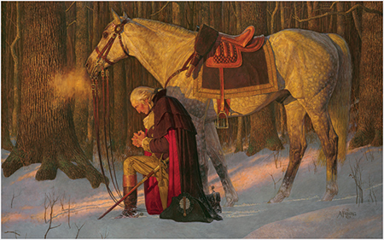
The Revolutionary War
One key moment in the American Revolution:
At Valley Forge…
The militia endured a harsh winter (1777) and trained hard, becoming a professional army.

Slide 19
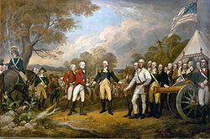
The Revolutionary War
Three Key Battles of the American Revolution:
The turning point of the American Revolution was the battle of Saratoga in 1777.

Slide 20
The Revolutionary War
Three Key Battles of the American Revolution:
The French where so impressed with the victory that they joined sides with USA against Great Britain.

Slide 21
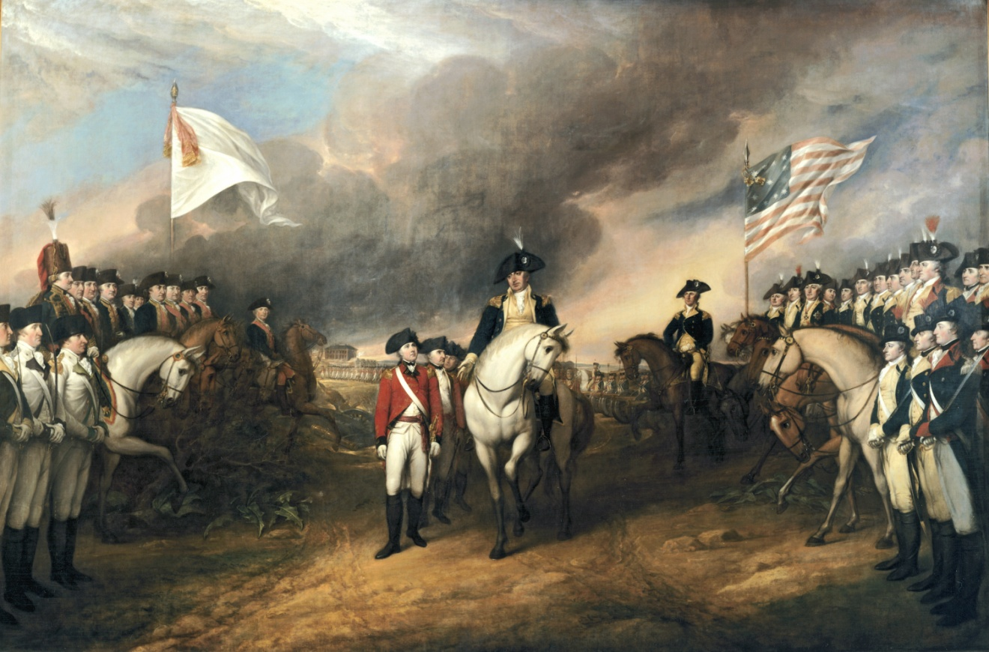
The Revolutionary War
Three Key Battles of the American Revolution:
The British surrendered at the battle of Yorktown in 1781.

Slide 22
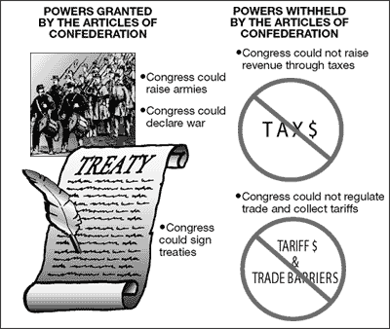
Second Continental Congress
Second Continental Congress
1775-1781
The Articles of Confederation united the Colonies as one, but did not have the power to tax individual colonies.

Slide 23
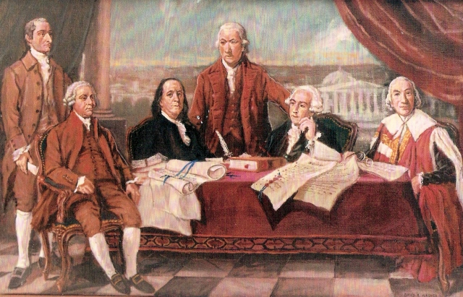
The Revolutionary War
The End of the War!
The Treaty of Paris was signed in 1783, ending the Revolutionary War and giving America the land to the Mississippi River.

