Slide 1
Manifest Destiny

Slide 2
Manifest Destiny
Manifest Destiny –
The belief that Americans were “destined” to own land from Ocean to Ocean.

Slide 3
Manifest Destiny
Americans wanted to spread DEMOCRACY from ocean to ocean.

Slide 4
Manifest Destiny
Settlers moved west to find a new life.

Slide 5
Northwest Ordinance
Passed in 1787, the NW Ordinance created the NW territory out of the lands north of the Ohio River and east of the Mississippi River.

Slide 6
Northwest Ordinance
The NW Ordinance provided a way to establish territories that could eventually become states.

Slide 7
Northwest Ordinance
60,000 people were needed in a territory before it could become a state.

Slide 8
Northwest Ordinance
Flip your notes sheet over
Discuss with your group what we should add as notes.

Slide 9
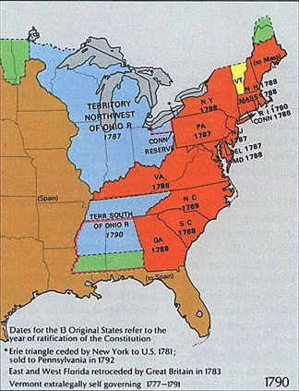
America’s Expansion
During the early 1800’s, the United States had its greatest expansion.
Between 1790 and 1820, the US doubled its size and added 10 new states.
1790
1820

Slide 10
Louisiana Purchase
Kansas, Nebraska, and South Dakota were now possible due to the Louisiana Purchase of 1803.

Slide 11
Santa Fe Trail
The Santa Fe Trail was a 900 mile trade route that helped goods to be sold in the southwest .

Slide 12
Manifest Destiny
The Oregon Country was claimed by the USA, Britain, Spain, and Russia.

Slide 13
Manifest Destiny
The beaver was almost extinct in Europe. In Oregon there were millions and their skins were very valuable.

Slide 14
Manifest Destiny
Mountain Men trapped the beavers and sent their skins back to the American Fur Company.

Slide 15
Manifest Destiny
In 1819 Spain agreed to the Adams-Onis Treaty, giving up it’s right to the Oregon.

Slide 16
Manifest Destiny
In 1824 Russia gave up any claim to the Oregon Territory.

Slide 17
Oregon Trail
The Oregon Trail was the earliest route through to the west coast.

Slide 18
Manifest Destiny
In 1844 the cry was “Fifty-four Forty or Fight.” The USA wanted total claim to Oregon.

Slide 19
Manifest Destiny
In 1846 Britain gave up it’s claim below the 49th Parallel.

Slide 20
Manifest Destiny
Discuss with your group what the cartoons might be for Oregon

Slide 21
Manifest Destiny
In the early 1800’s Spain offered tracts of land for people who would move to Texas.

Slide 22
Manifest Destiny
Stephen F. Austin came to settle and recruited 300 other families as well.

Slide 23
Manifest Destiny
During this time Mexico declared their independence from Spain.

Slide 24
Manifest Destiny
By 1830 there were 9 Americans for every 1 Mexican in Texas.

Slide 25
Manifest Destiny
In 1830 the Mexican government closed the border to Americans and stopped trade.

Slide 26
Manifest Destiny
In 1836 Texas declared independence and lost an epic battle at the Alamo.

Slide 27
Manifest Destiny
A few months later Texas would gain her independence with the defeat of Santa Anna at the battle of San Jacinto.

Slide 28
Manifest Destiny
In 1845 Texas was annexed into the United States of America as the 28th state to join the Union.

Slide 29
Manifest Destiny
Joseph Smith and Brigham Young led the Mormons on pilgrimage (the Mormon Trail) to Utah where they established their church.

Slide 30
Manifest Destiny
In California, Mexican ranch owners (rancheros) used Native Americans as slaves to work on their ranches.

Slide 31
Manifest Destiny
USA President James Polk wanted New Mexico and California to complete his belief in Manifest Destiny.

Slide 32
Manifest Destiny
Polk offered Mexico money for New Mexico and California. Mexico said “No!”.

Slide 33
Manifest Destiny
Mexico threatened to retake Texas and bring the state back into their nation. This provoked a WAR!

Slide 34
Manifest Destiny
In1847 the USA Army captured Mexico City forcing the Mexican government to surrender.

Slide 35
Manifest Destiny
The USA and Mexico agree to peace in the Treaty of Guadalupe Hidalgo.

Slide 36
Manifest Destiny
Discuss what the cartoons for Texas might be….

Slide 37
Manifest Destiny
In the Mexican Cession the USA bought California and New Mexico for $15 million.

Slide 38
Manifest Destiny
In 1853 the USA paid Mexico $10 million in the Gadsden Purchase.

Slide 39
Manifest Destiny
Before the Gadsden Purchase, the Rocky Mountains were a barrier that all moving west had to cross.

Slide 40
Manifest Destiny
In 1848 gold was discovered at Sutter’s Mill in California.

Slide 41
Manifest Destiny
In 1849 the secret was out and a GOLD RUSH took place as people flocked to California.

Slide 42
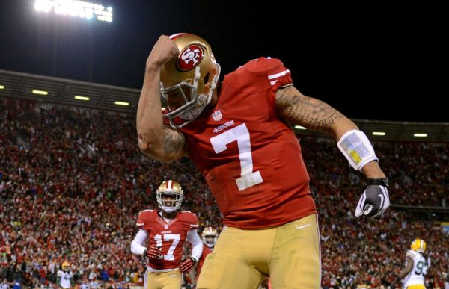
Gold Rush Immigrants
Those who arrived in 1849 were called the “forty-niners.”
Many of the gold seekers came to California by sea.

Slide 43
Gold Rush Immigrants
The Chinese arrived in the United States to work on the west coast during the Gold Rush.
This group of immigrants established California’s Chinese American community.

Slide 44
Manifest Destiny
John Gast, a famous artist, painted the Manifest Destiny painting entitled, “American Progress” in 1872.

