Slide 1
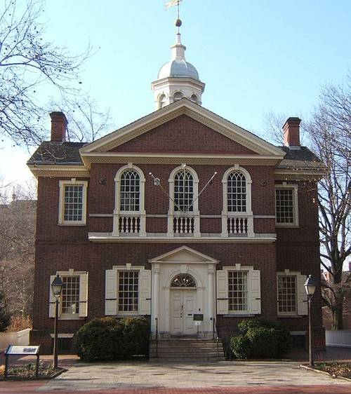
The Battle of Lexington and Concord
Upon hearing of the Intolerable Acts, the colonies assembled.

Slide 2
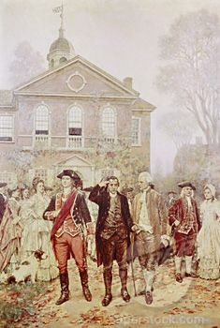
The Battle of Lexington and Concord
12 of the 13 Colonies were represented.
56 Delegates attended.

Slide 3
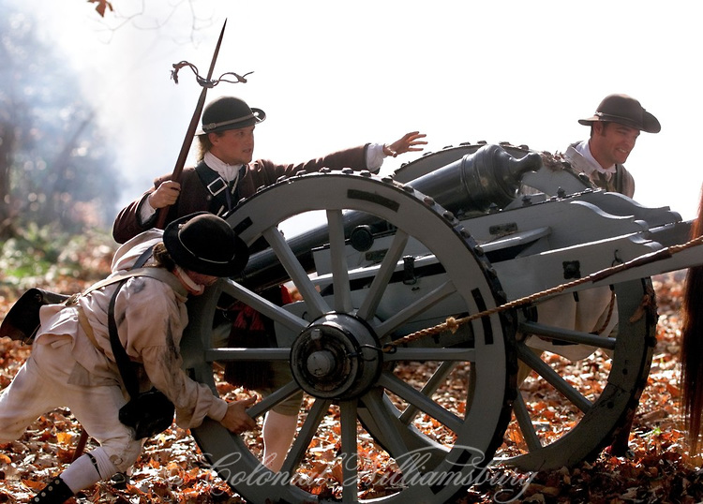
The Battle of Lexington and Concord
Delegates tell British if they use force against the colonies, the colonies would fight back.

Slide 4
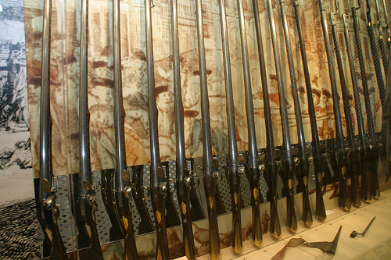
The Battle of Lexington and Concord
To prepare for the British attack, the New England militia stockpiled weapons at Concord.

Slide 5
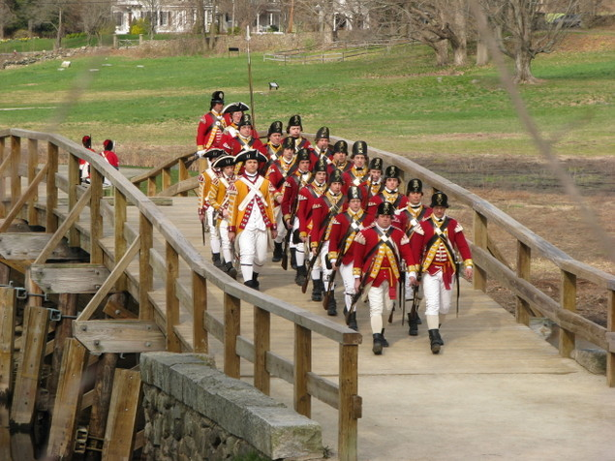
The Battle of Lexington and Concord
The British learn of the weapons at Concord and send 700 troops to seize them.

Slide 6
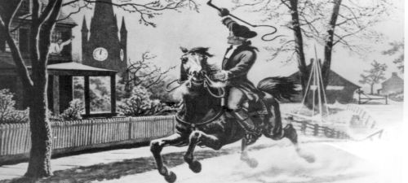
The Battle of Lexington and Concord
Paul Revere and Wentworth Cheswell made all night rides to warn, “The British are Coming!”
“Light one lantern if they go by land. Hang two lanterns if they go by sea"?

Slide 7
The Battle of Lexington and Concord
At Lexington, the British encountered 70 Minutemen. The British fired, “The shot heard around the world.”

Slide 8
The Battle of Lexington and Concord
When the British arrived at Concord, the weapons had all been moved.

Slide 9
The Battle of Lexington and Concord
As the British returned to Boston, hundreds of Minutemen picked them off like ducks on a pond.

Slide 10
The Battle of Lexington and Concord
More British soldiers arrived from Boston to help save their comrades.

Slide 11
The Battle of Lexington and Concord
The Battle of Lexington and Concord, was the first of the American Revolution and a victory for the Colonists.

Slide 12
The Battle of Lexington and Concord
1. Why is this Battle the Birth of a Nation?
2. Why is the Militia so important and who is expected to serve?
3. How many British soldiers are at the Battle?
4. What army could stand toe to toe with the British Army?
5. What do the Red Coats find in Concord?
6. Who tipped off the Red Coats of where the arms stash would be?
7. How many Militia where at the Second round of Lexington?

