Slide 1
John Adams
President
John
Adams

Slide 2
John Adams
In the election of 1796 John Adams (Federalist) defeated Thomas Jefferson (Democratic –Republican).

Slide 3
John Adams
Adams wanted to negotiate a treaty. France sent three diplomats (X, Y, and Z) to discuss the seized ships.

Slide 4
John Adams
X, Y, and Z demanded $250,000 in cash to return the ships.

Slide 5
John Adams
Angry Americans cried out, “Millions for defense. Not one cent for tribute!”

Slide 6
John Adams
Congress approved money to build more ships for the navy.

Slide 7
John Adams
Adams has Congress pass the Alien and Sedition Acts.

Slide 8
John Adams
Adams could now deport anyone from another country that the government considered, “dangerous”.

Slide 9
John Adams
Adams had Congress pass the Alien and Sedition Acts.

Slide 10
John Adams
With the Sedition Acts, the government could imprison any newspaper employee that criticized the U.S. during a time of War.

Slide 11
The Presidency of Thomas Jefferson

Slide 12
Thomas Jefferson ran in 1800 as Democratic Republican Candidate.

Slide 13
Thomas Jefferson favored the expansion of state’s rights.

Slide 14
Revolution of 1800
* Jefferson ties with his Vice Presidential running mate, Aaron Burr.

Slide 15
Revolution of 1800
* The House of Representatives breaks the tie and votes for Jefferson.

Slide 16
Marbury vs. Madison
* President Adams passes new law that appoints 16 new judges just days before he leaves office.

Slide 17
Marbury vs. Madison
Supreme Court says the new law is unconstitutional or against the law.

Slide 18
Marbury vs. Madison
This leads to Judicial Review.
Judicial Review allows the Supreme Court to overrule laws passed by Congress.

Slide 19
Louisiana Purchase 1803
France gets territory from Spain in 1800.
Jefferson buys territory from France for $15 million dollars.
This doubles the size of the United States.

Slide 20
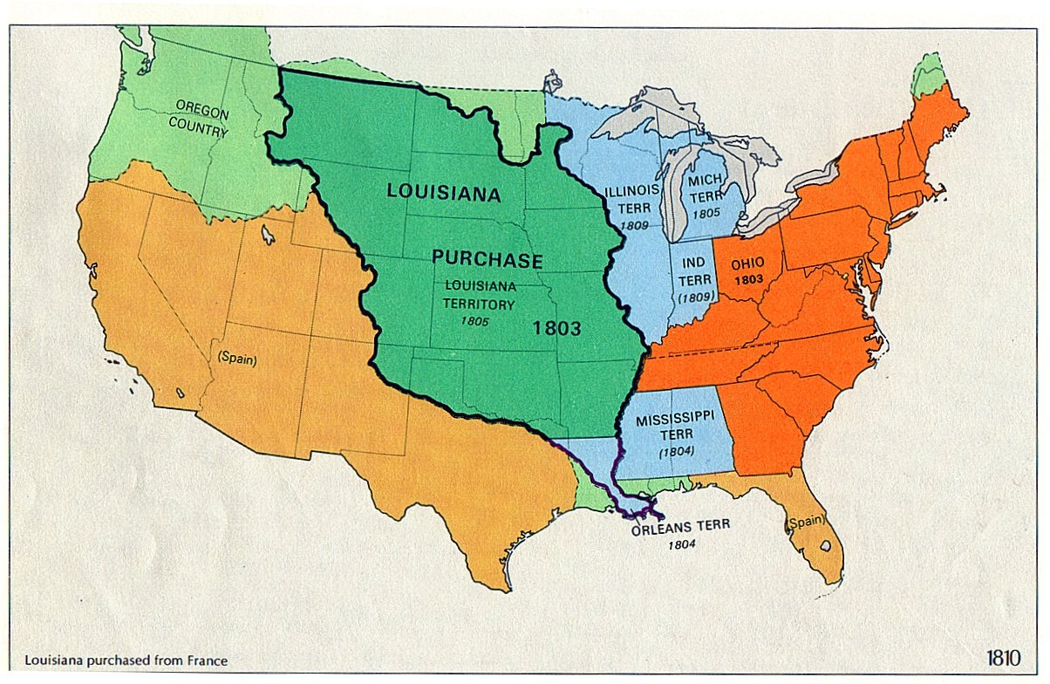

Slide 21
Lewis & Clark
Meriwether Lewis and William Clark are commissioned by Jefferson to explore Louisiana Territory.

Slide 22
Lewis & Clark
Jefferson asks Lewis and Clark to make peace with the Indians.

Slide 23
Embargo Act of 1807
USA closes American Ports.
Hurts USA Economy.
Americans hate it!
Video

