Slide 1
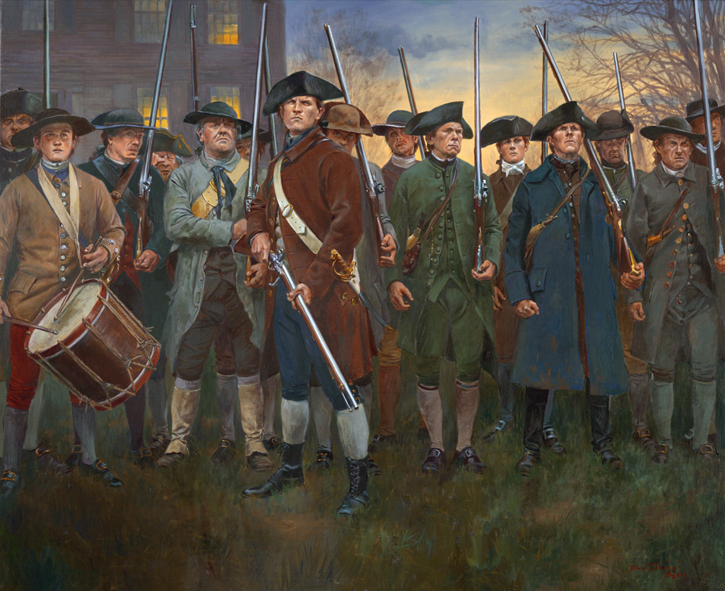
Revolution!

Slide 2
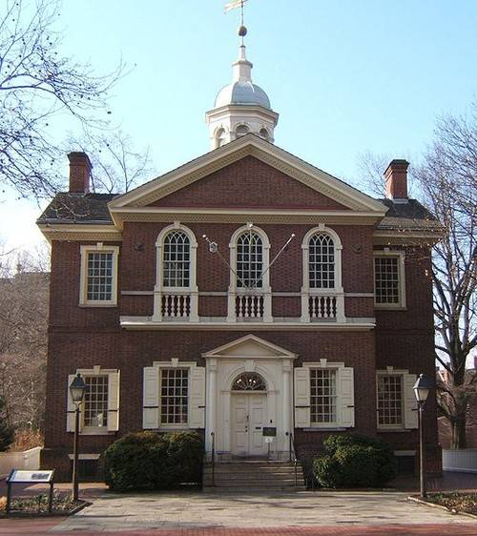
First Continental Congress
The First Continental Congress met
September 5, 1774
Carpenter Hall
Philadelphia, Pennsylvania

Slide 3
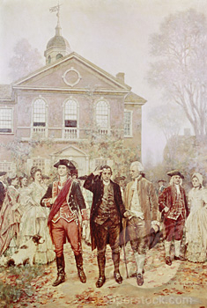
First Continental Congress
The First Continental Congress :
12 of the 13 Colonies were represented.
Georgia did not attend.
56 Delegates attended.

Slide 4
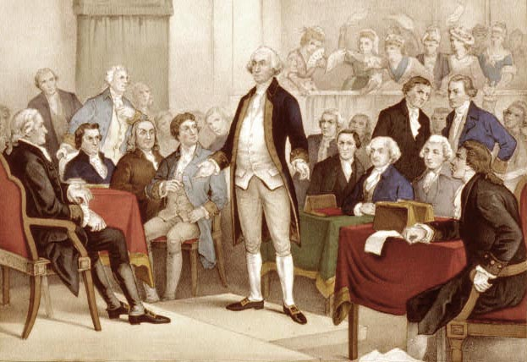
First Continental Congress
The First Continental Congress included :
John Adams, Sam Adams, & George Washington.

Slide 5
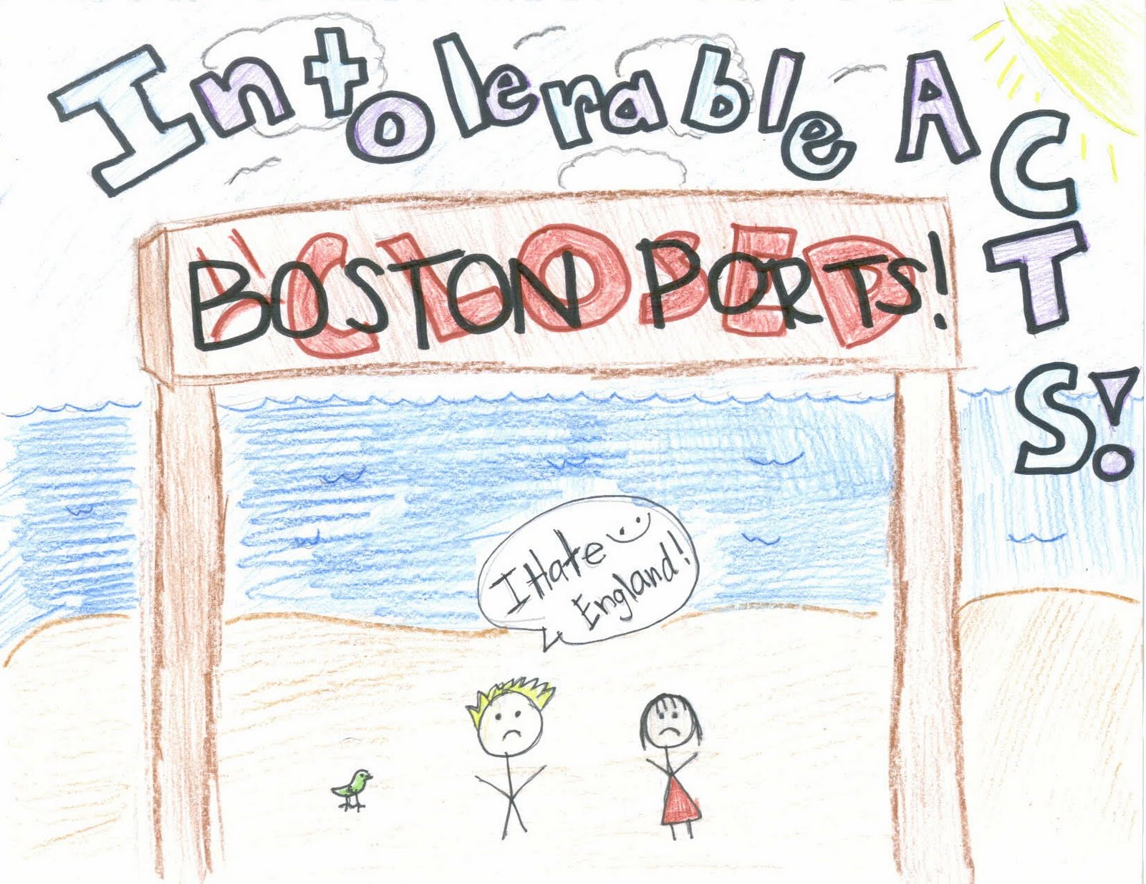
First Continental Congress
The First Continental Congress happened :
As a response to the Intolerable Acts.

Slide 6
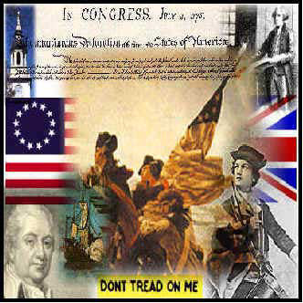
First Continental Congress
The First Continental Congress was composed of Patriots and Loyalists :
Patriots – Those committed to declare independence from England.

Slide 7
First Continental Congress
The First Continental Congress was composed of Patriots and Loyalists :
Loyalists – Those loyal to the King but wanting an end to taxes.

Slide 8
First Continental Congress
Turn and Talk
What would have been a good reason to be a Loyalist?
What would have been a good reason to be a Patriot?

Slide 9
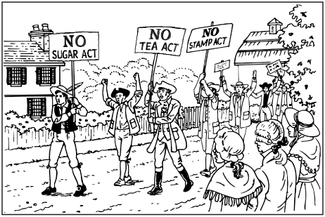
First Continental Congress
The First Continental Congress was composed of Patriots and Loyalists :
Patriots and Loyalists united together to ask the King to stop
taxation without representation.

Slide 10
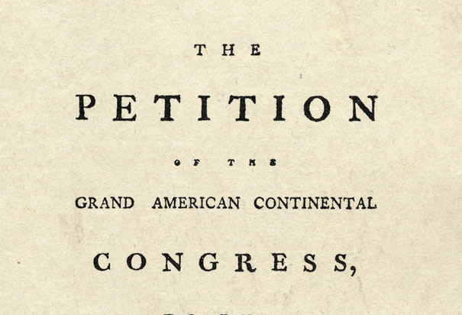
First Continental Congress
The First Continental Congress petitioned the King :
Patriots and Loyalists made a list of grievances that they submitted to King George.

Slide 11
First Continental Congress
Turn and Talk
What complaints would you have had against King George? List as many as you can.

Slide 12
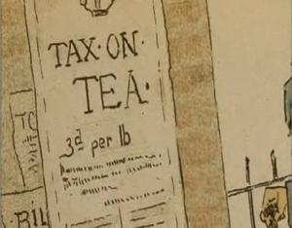
First Continental Congress
The First Continental Congress told the King :
They would continue to boycott British goods..

Slide 13
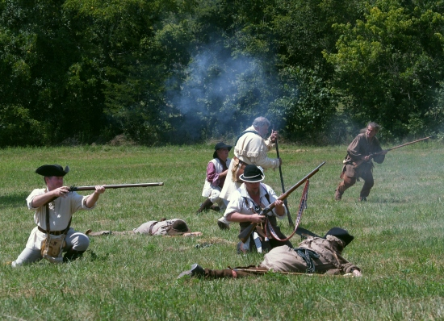
First Continental Congress
The First Continental Congress told the King :
They would build up a militia (local army) in preparation for a war if he continued to tax them.

Slide 14
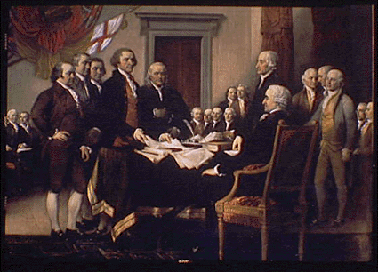
First Continental Congress
The First Continental Congress looked to the future :
They decided that we need to have a 2nd Continental Congress once King George responded.

Slide 15
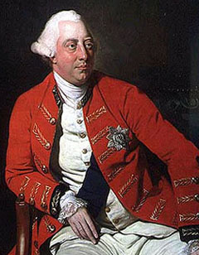
First Continental Congress
King George and the British Parliament :
They saw the list of Grievances as treason.

Slide 16
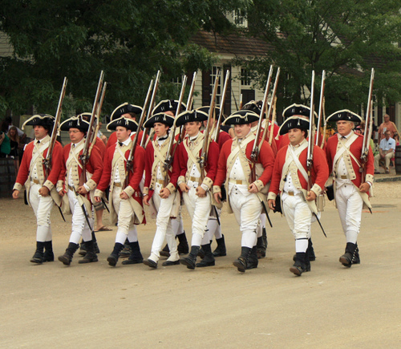
First Continental Congress
King George and the British Parliament :
They decided to send more British soldiers to put down the rebellion.

Slide 17
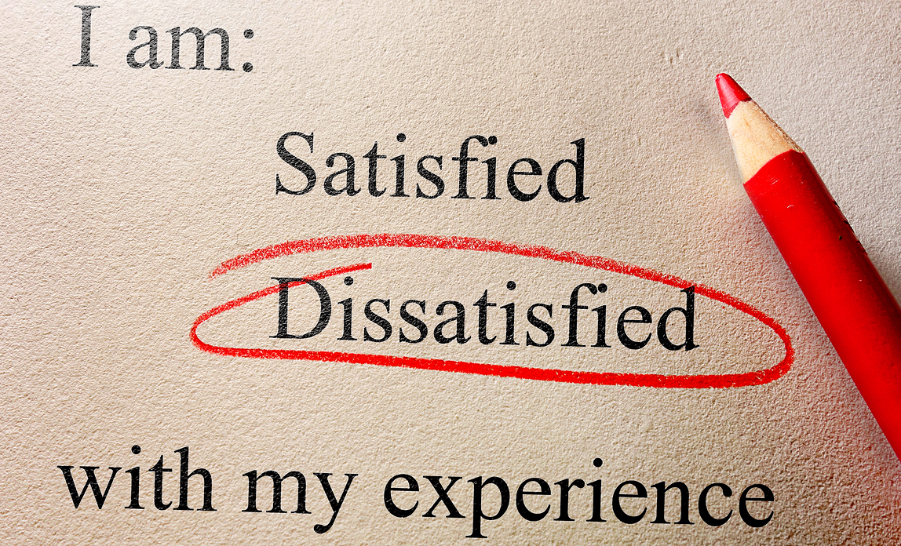
First Continental Congress
Your Turn!
In your group, list as many grievances as you can about SSMS. We will summarize them into one list.

