Slide 1

European Explorers
Learning about the
Spanish,
French, and English explorers.

Slide 2

European Explorers
The Spanish came to North America because of:
God

Slide 3

European Explorers
The Spanish came to North America because of:
Glory.

Slide 4
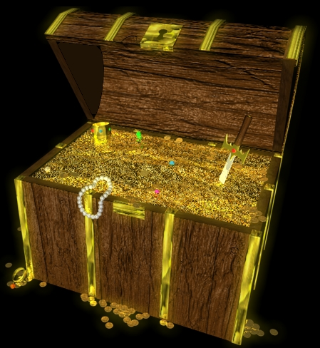
European Explorers
The Spanish came to North America because of:
Gold.

Slide 5
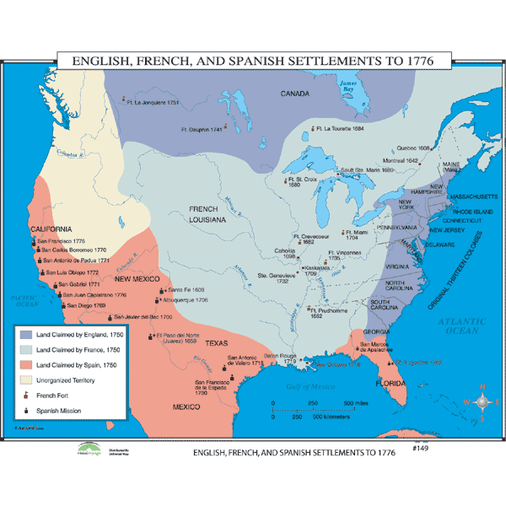
European Explorers
The Spanish explored Florida, the Southwest U.S., Mexico, and the Caribbean.

Slide 6
European Explorers
The French came to N. America in search of the:
Northwest Passage .

Slide 7
European Explorers
The French came to N. America in search of a faster, cheaper trade route.

Slide 8
European Explorers
The French explored the : Louisiana Territory, Canada, and the Caribbean Islands.

Slide 9
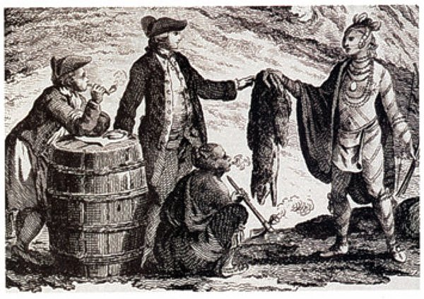
European Explorers
The French utilized the Mississippi River to expand their fur trading.

Slide 10
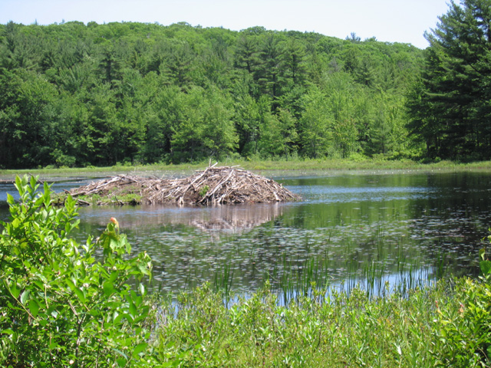
European Explorers
The English came to N. America in search of :
Gold and Natural Resources.

Slide 11
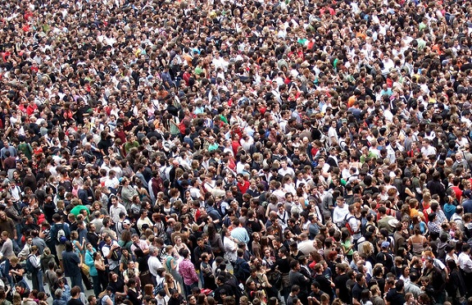
European Explorers
Some English came to N. America because of :
Over population and pollution.

Slide 12

European Explorers
Some English came to N. America because of :
Religious intolerance.

Slide 13

European Explorers
Through the use of a joint-venture, exploration became possible.

Slide 14

European Explorers
A joint-venture, is where two or more people invest money together for a profit.

Slide 15
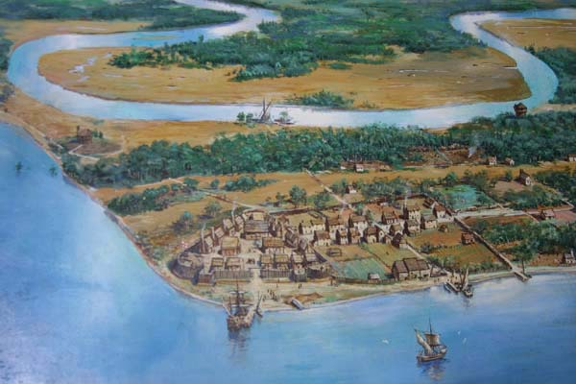
European Explorers
The English Colonial Era will begin in 1607 with the first permanent settlement at
Jamestown.

Slide 16
European Explorers
Explorers risked their lives for:
Fame , curiosity, and Pride for their nation.

Slide 17
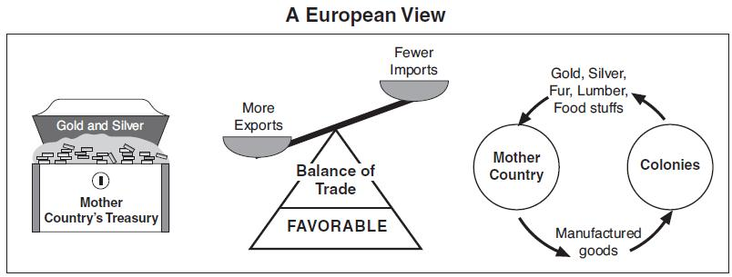
European Explorers
When countries compete for land and resources they are involved in Mercantilism.

