Slide 1
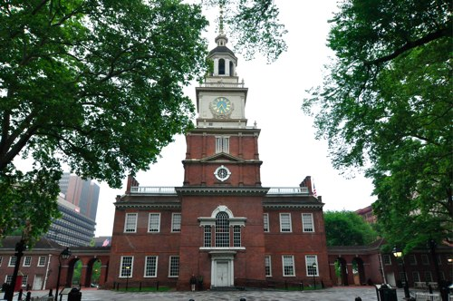
Constitutional Convention 1787
What: A convention to write a permanent constitution.
When: May-September 1787
Where: Independence Hall
Philadelphia, PA

Slide 2
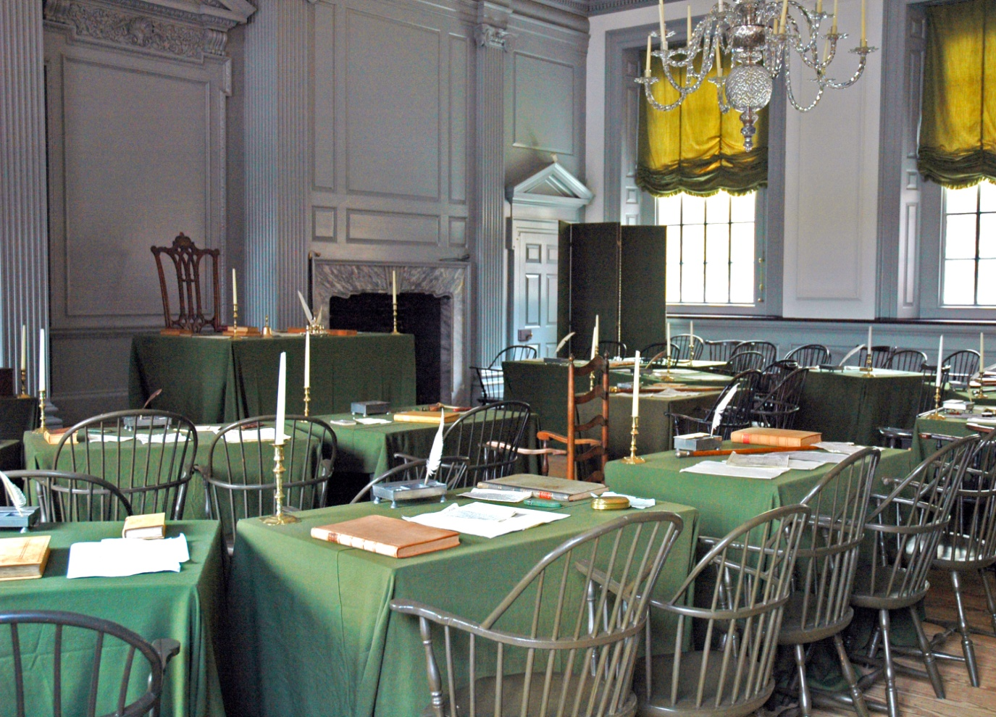
Constitutional Convention 1787
Who: 12 of 13 states (R.I. stayed home).
55 delegates.
Set up: organize committees to overcome disagreements.

Slide 3
Constitutional Convention 1787
Why: Because the Articles of Confederation would not allow states to be taxed and thus were WEAK!
Shay’s Rebellion

Slide 4
COMPROMISE
noun - a settlement of differences in which each side makes concessions (gives in a little) to come to a result which solves a problem

Slide 5
3 MAJOR COMPROMISES:
1. GREAT COMPROMISE
2. 3/5 COMPROMISE
3. TRADE COMPROMISE

Slide 6
Major debate was over how to set up the legislative branch of government

Slide 7
It becomes a battle between smaller states and the ones with larger populations
VS

Slide 8
Several states submit plans for the type of legislature they want

Slide 9
VIRGINIA PLAN
1) The legislative branch would have two houses
2) Both houses would assign representatives based on wealth/population

Slide 10
NEW JERSEY PLAN
1) The legislature would have one house
2) Each state would have only one vote in the legislature

Slide 11
THE GREAT
COMPROMISE

Slide 12
GREAT COMPROMISE
The legislature would have two houses

Slide 13
GREAT COMPROMISE
SENATE – number of representatives for each state are equal
= 2 senators
= 2 senators

Slide 14
GREAT COMPROMISE
HOUSE OF REPRESENTATIVES - based on population
= 1 representative
(493,000 people)
= 52 representatives
(38,800,000 people)

Slide 15
CONGRESS
SENATE (100)
EVERY DATE HAS EQUAL NUMBER
HOUSE OF REPRESENTATIVES (435)
BASED ON POPULATION SO NOT EQUAL FOR EVERY STATE

Slide 16
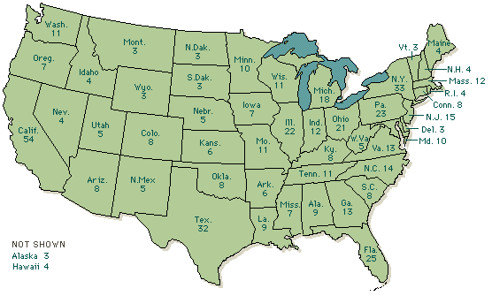
TOTAL NUMBER OF REPRESENTATIVES IN CONGRESS FROM EACH STATE

Slide 17
THE GREAT COMPR0mISE
VIRGINIA PLAN
2 houses for legislature
NUMBER of people in congress set by population
Favors Large States
SENATE
Number of people BASED ON EQUALITY = EACH STATE HAS SAME NUMBER
GREAT COMPROMISE
THE LEGISLATURE WILL HAVE 2 HOUSES
NEW JERSEY PLAN
1) 1 house for legislature
2) Each state would have only one vote in the legislature
3) Favors Small States
Number of people BASED ON populations
HOUSE OF REPRESENTATIVES
Unit 5 – Creating a Government – Page 4 of 10

Slide 18
Next major issue to be decided is slavery and if slaves should be counted as population

Slide 19
3/5
COMPROMISE

Slide 20
WHAT IS THE PROBLEM:
should slaves be counted as population for taxes and/or to determine representatives in the legislature

Slide 21
NORTH WANTS:
Northern states want slaves to not be counted to determine representatives but to be counted for taxes
X

Slide 22
SOUTH WANTS:
X
Southern states want slaves to be counted to determine representatives but not for taxes

Slide 23
THE 3/5 COMPROMISE:
Compromise made was count slaves as 3/5 of a person
This is used for taxes and to set up the number of reps in Congress

Slide 24
TRADE
Northern states agree to do nothing about slave trade until 1808
Southern states agree to allow national government to regulate trade

Slide 25
No state gets everything they wanted but they wrote a constitution they thought would work overall

Slide 26
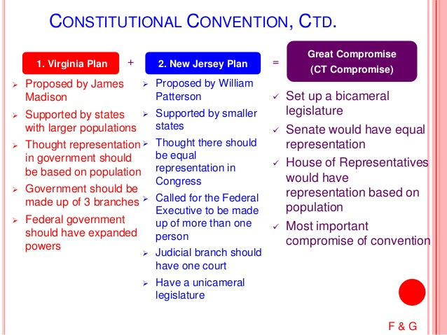

Slide 27

Constitutional Convention 1787
Objections:
That the Convention had exceeded its authority in producing a new Constitution.
.

Slide 28
Constitutional Convention 1787
Objections:
That the Constitution established the basis for a monarchical regime.
.

Slide 29
Constitutional Convention 1787
Objections:
That the Constitution lacked explicit protections for individual and states rights.
.

Slide 30
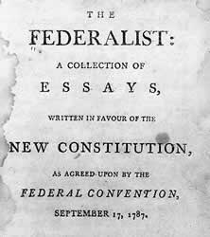
Constitutional Convention 1787
Federalist Papers:
Writings published in New York newspapers that assured public that they could trust the new constitution.
.

Slide 31
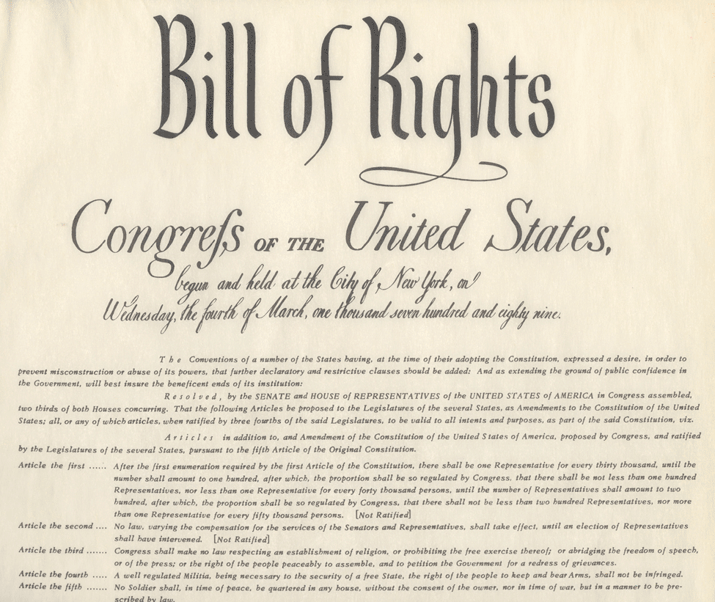
Constitutional Convention 1787
Bill of Rights:
10 Amendments (changes) to the Constitution were proposed on September 25, 1789.
.

Slide 32
Constitutional Convention 1787
Bill of Rights:
10 Amendments (changes) to the Constitution were ratified by ¾ of the states on December 15, 1791.
.

Slide 33
Constitutional Convention 1787
Bill of Rights:
1st Amendment
Freedom of Religion
“ …” of Speech
“…” of Press
“…” of Assembly
“…” to Petition Government
.

Slide 34
Constitutional Convention 1787
Bill of Rights:
2nd Amendment
Right to Bear Arms – citizens have the right to own firearms.
.

Slide 35
Constitutional Convention 1787
Bill of Rights:
3rd Amendment
Quartering Soldiers – Government can not make you house soldiers.
.

Slide 36
Constitutional Convention 1787
Bill of Rights:
4th Amendment
Search and Seizure – The government must have a warrant before searching.
.

Slide 37
Constitutional Convention 1787
Bill of Rights:
5th Amendment
Due Process – Must be evidence before you are indicted by a Grand Jury for a crime.
.

Slide 38
Constitutional Convention 1787
Bill of Rights:
6th Amendment
Rights to a Fair Trial – Speedy and public trial.
.

Slide 39
Constitutional Convention 1787
Bill of Rights:
7th Amendment
Rights In a Civil Case – Right to a jury trial in civil case.
.

Slide 40
Constitutional Convention 1787
Bill of Rights:
8th Amendment
Cruel and Unusual Punishment – excessive fines and punishment prohibited.
.

Slide 41
Constitutional Convention 1787
Bill of Rights:
9th Amendment
Rights Retained by the People – rights not mentioned are protected.
.

Slide 42
Constitutional Convention 1787
Bill of Rights:
10th Amendment
Powers retained by the states and the people – rights not given Feds are retained by states.
.

Slide 43

Constitutional Convention 1787
.

