Slide 1
British Parliamentary Acts
England was in debt after the French and Indian War.

Slide 2
British Parliamentary Acts
King George believed the Colonists should pay for the War.

Slide 3
British Parliamentary Acts
King George decided to take away freedoms of the Colonists.

Slide 4
British Parliamentary Acts
King George decided to tax the Colonists.

Slide 5
British Parliamentary Acts
I Can’t Take It Anymore!
The British continued to take away freedoms and tax the colonists until finally…

Slide 6
British Parliamentary Acts
The Proclamation Act
Date: 1763
Act - Prohibited colonists from moving west of Appalachian Mountains.

Slide 7
British Parliamentary Acts
The
Sugar Act
Date: 1764
Act - Taxed sugar, coffee, wine and other imports.

Slide 8
British Parliamentary Acts
The
Stamp Act
Date: 1765
Act - Taxed anything printed on paper by requiring stamps to be placed on all paper. Newspapers, marriage licenses, deeds, etc.

Slide 9
British Parliamentary Acts
The
Quartering Act
Date: 1765
Act - Colonists must provide housing for British Soldiers.

Slide 10
British Parliamentary Acts
The
Townshend
Act
Date: 1767
Act - Taxed glass, lead, paints, etc. Added more tax collectors.

Slide 11
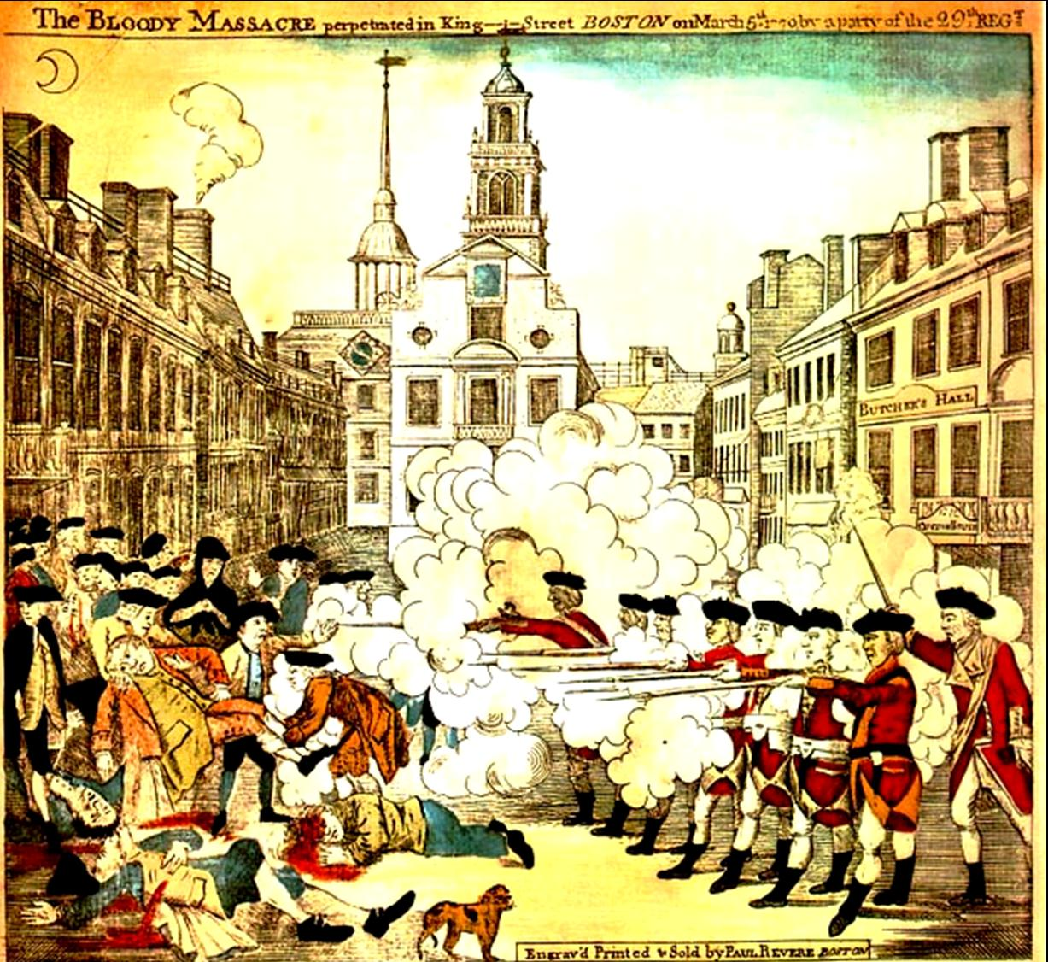
The Boston Massacre
Presentation by Robert L. Martinez
Primary Content Source: From Colonies to Country by Joy Hakim.
Images as cited.

Slide 12
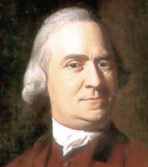
Samuel Adams was the leader of the “Sons of Liberty” and an organizer who helped start a revolution. John Adams was a farm owner and a lawyer, who helped lead that revolution.
http://www.knowledgerush.com/wiki_image/6/63/SamuelAdamsSmall.jpeg

Slide 13
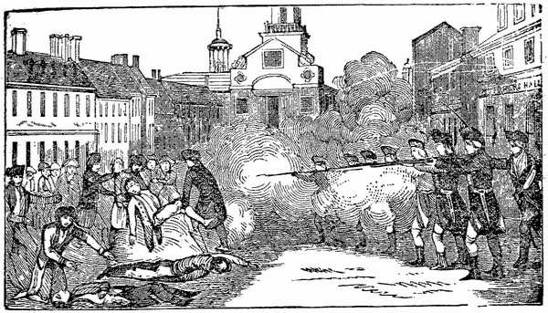
Here is a story about both Adams cousins; the story of the Boston Massacre. A massacre is a gruesome killing. That’s what happened in Boston in 1770.
http://www.walterbright.com/AmericanHistory/bostonmassacre.html

Slide 14
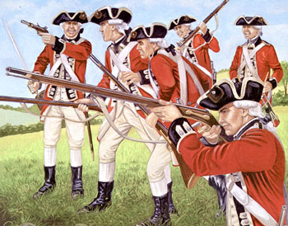
English soldiers, who were called “redcoats” because of the color of their uniforms, were to be quartered in American towns.
http://www2.gpmd.com/image/i/imxs0002.jpg

Slide 15
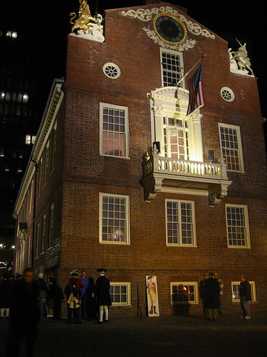
Well, the Americans didn’t want British redcoats quartered in their towns, or even in their country.
http://www.flickr.com/photos/timony/108553519/

Slide 16
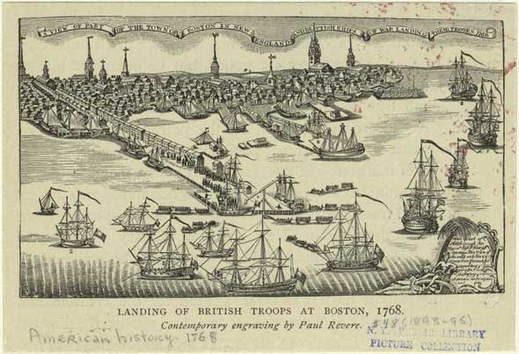
In 1768 the British fleet sailed into Boston harbor and unloaded regiment after regiment of redcoats.
http://www.bostonmassacre.net/images/british-troops-arriving.jpg

Slide 17
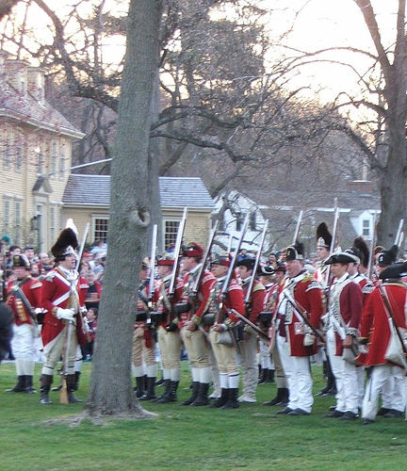
So when the soldiers arrived in 1768, the colonists weren’t very kind to them. Sometimes they threw snowballs or rocks.

Slide 18
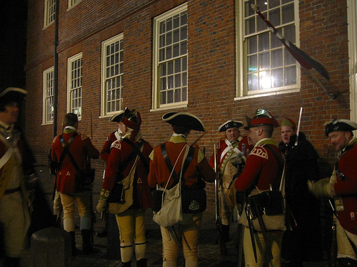
Most of the English soldiers didn’t want to be in America anyway. They were poorly paid, and many were homesick.
http://www.flickr.com/photos/timony/108553670/

Slide 19
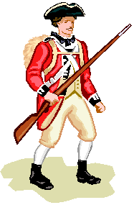
On a freezing March day in 1770, one of the king’s soldiers was looking for work to earn some extra money. Someone started making fun of him and told him to get a job cleaning toilets.
http://rblewis.net/technology/EDU506/WebQuests/revolution/redcoat.gif

Slide 20
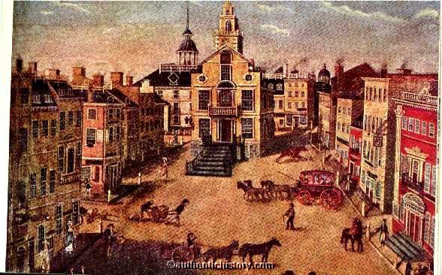
One thing led to another, and there was a fight. Soon a noisy, jeering group of Colonists gathered in front of the Boston Custom House.
http://www.authentichistory.com/antebellum/revolution

Slide 21
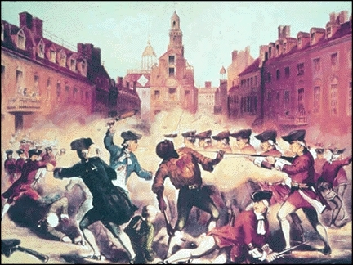
They began pushing and shoving and throwing stones at the British sentry. He got knocked down and he called for help.
http://declarationsandexclusions.typepad.com/foolblog/images/pelham_boston_massacre.jpg

Slide 22
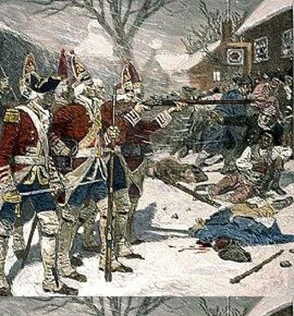
Capt. Thomas Preston came to the rescue with eight British soldiers. There is some confusion about what happened next.
http://www.bostonmassacre.net/gravure-british-troops.htm

Slide 23
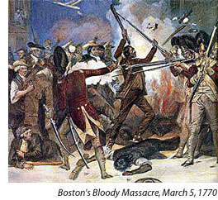
The mob is said to have taunted the redcoats, yelling “Fire! Fire!” Captain Preston is said to have yelled, ‘Hold your fire!” Then a British soldier was hit with a big stick.
http://www.americanrevolution.com/images/BostonMassacre2.jpg

Slide 24
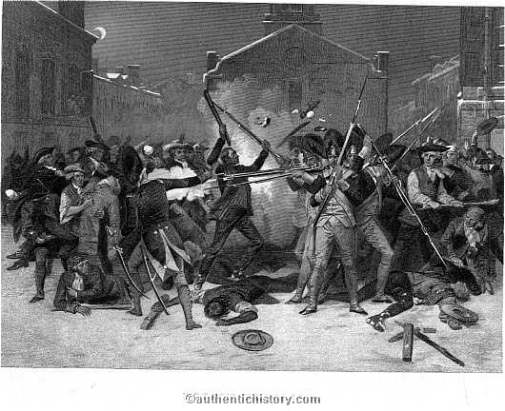
He claimed he heard the word “fire,” so he fired his gun into the crowd. The Colonists moved forward; the redcoats panicked and fired at unarmed people.
http://www.authentichistory.com/antebellum/revolution

Slide 25
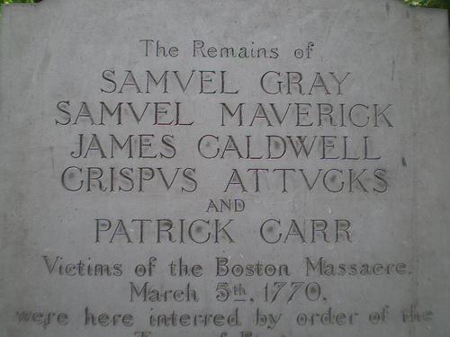
Five Americans die, seven were wounded.
http://www.flickr.com/photos/hanneorla/2831657338/

Slide 26
Boston Massacre
The first African American to die for American Independence was Crispus Attucks.

Slide 27
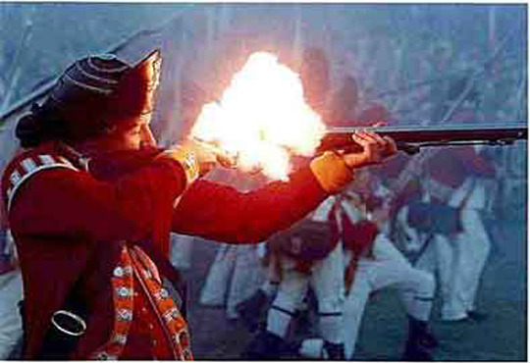
The victims perhaps had some blame but got worse than they deserved. The soldiers were professionals, who shouldn’t have panicked. The whole thing shouldn’t have happened.
http://www.bostonmassacre.net/gravure-british-troops.htm

Slide 28
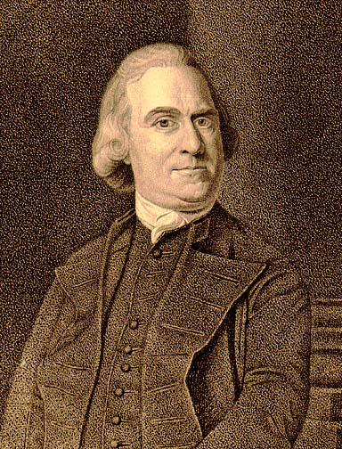
Samuel Adams made the most of it. He called it the Boston Massacre and had Paul Revere engrave a picture of the scene.
http://www.earlyamerica.com/portraits/samadams.html

Slide 29
The picture that Paul Revere chose to etch into a piece of copper, so it could be printed over and over again, showed British soldiers firing at peaceful Boston citizens.

Slide 30
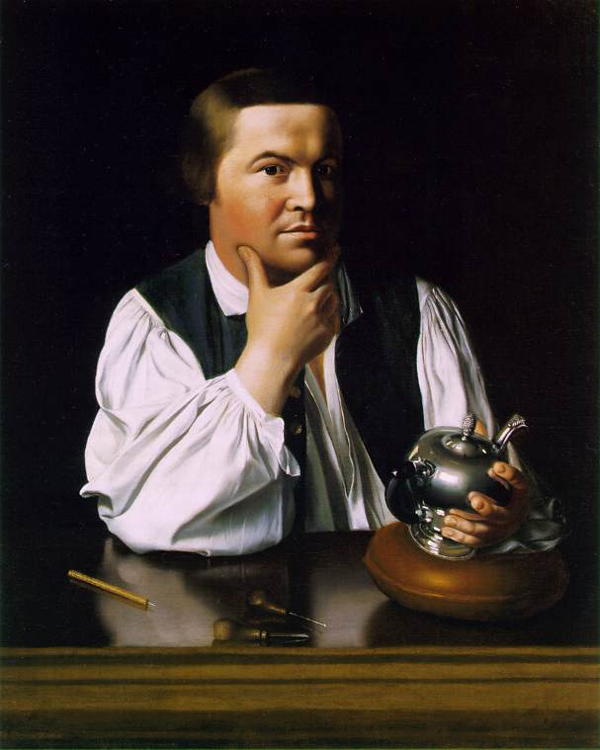
That wasn’t the way it had happened – Adams and Revere knew that – but the drawing made good propaganda. It made people furious at the British.
Paul Revere
http://www.artchive.com/artchive/c/copley/revere.jpg

Slide 31
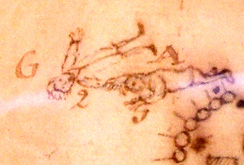
That drawing was soon seen all over the colonies. It helped start a war.
Drawing by Paul Revere of Boston Massacre victims
http://www.flickr.com/photos/gruenemann/457079831/

Slide 32
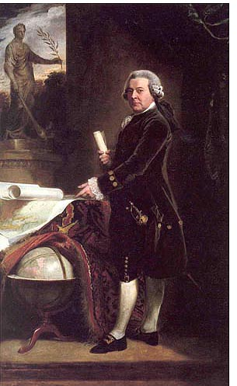
There is one hero in the story of the Boston Massacre, John Adams. John didn’t want British soldiers in Boston either. But, he was fair and he always did what he thought was right.
http://www.americanrevolution.com/ppl_john_adams.html

Slide 33
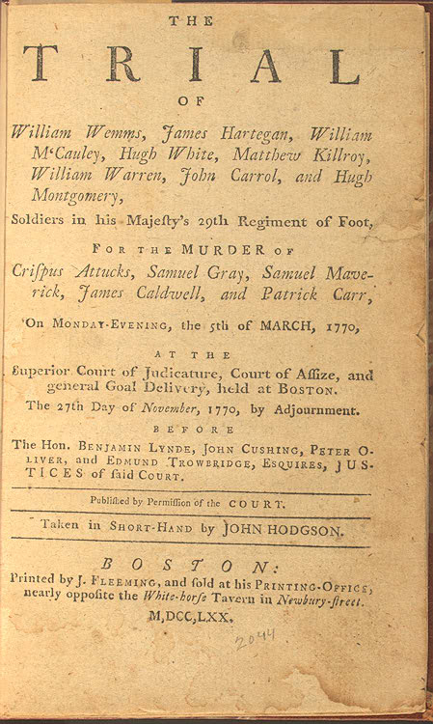
He believed the redcoats should have a fair trial. He knew they needed a good lawyer, and he was one of the best in the colonies.
http://www.loc.gov/exhibits/treasures/images/vc006709.jpg

Slide 34
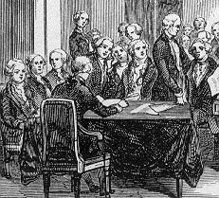
Adams argued that the soldiers had defended themselves against an angry mob. A Boston jury found six of the soldiers not guilty. Two soldiers were found guilty of manslaughter, they were branded on their thumbs.
http://www.law.umkc.edu/faculty/projects/ftrials/bostonmassacre/scene1a.jpg

Slide 35
British Parliamentary Acts
The
Tea
Act
Date: 1773
Act - The only tea that Colonists were allowed to buy was tea sold by a British Company.

Slide 36
A Tax on Tea
Parliament began taxing tea. Tea was the most important beverage in the colonies.
The colonists decided to boycott all British tea.

Slide 37
The Boston Tea Party
Colonists dressed up like Mohawk Indians and boarded three British ships full of tea.
The colonists dumped all the tea into the harbor, about 90,000 pounds.
King George III was furious!

Slide 40
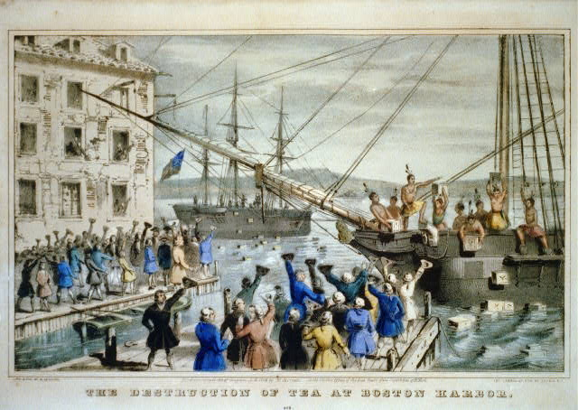
Political cartoon showing the reaction to the Boston Tea Party

Slide 41
British Parliamentary Acts
The
Intolerable
Acts
Date: 1774
Act - Port of Boston closed. Town Hall meeting prohibited. Increased number of British soldiers in Boston.

Slide 42
British Parliamentary Acts
I Can’t Take It Anymore!
The British continued to take away freedoms and tax the colonists until finally…

