Slide 1
Andrew Jackson

Slide 2
Andrew Jackson
Jackson was a hero of the War of 1812.

Slide 3
Andrew Jackson
He led the USA to victory at the Battle of New Orleans.

Slide 4
Andrew Jackson
His troops nicknamed him “Old Hickory” because he was so tough.

Slide 5
Andrew Jackson
He was elected as a Democrat for President in 1828.

Slide 6
Andrew Jackson
He was known as the President of the “Common Man”.

Slide 7
Andrew Jackson
Jackson was known for the Bank War.

Slide 8
Andrew Jackson
Jackson felt the National Bank favored the wealthy of America.

Slide 9
Andrew Jackson
He closed the National Bank and return power to the states.

Slide 10
Andrew Jackson
Jackson was known for the Nullification Crisis.

Slide 11
Andrew Jackson
South Carolina felt that tariffs hurt the south and helped the north.

Slide 12
Andrew Jackson
South Carolina said they’d “nullify” or “cancel” the tariff laws.

Slide 13
Andrew Jackson
Jackson said that the states had to obey federal laws.

Slide 14
Andrew Jackson
He had Congress pass the
Force Bill. The military would force payment.

Slide 15
Andrew Jackson
The Trail of Tears was a sad policy invoked by President Jackson.

Slide 16
Andrew Jackson
The Trail of Tears was a sad policy invoked by President Jackson.

Slide 17
Andrew Jackson
Jackson wanted to “civilize” Native Americans and keep them from a “wandering life”.

Slide 18
Andrew Jackson
What Jackson really wanted was the land and resources of Georgia and Alabama.

Slide 19
Andrew Jackson
President Jackson had Congress pass the Indian Removal Act of 1830.

Slide 20
Andrew Jackson
The Indians sued to stay on their land and won in the Supreme Court.

Slide 21
Andrew Jackson
The case, Worchester vs. Georgia and the ruling was ignored by Jackson.

Slide 22
Andrew Jackson
Between 1831-1837 46,000 Native Americans were forced off their land.

Slide 23
Andrew Jackson
4000 of the 15,000 Cherokees died on the Trail of Tears.

Slide 24
Andrew Jackson
The tribes were all given land in what we now know as Oklahoma.

Slide 25
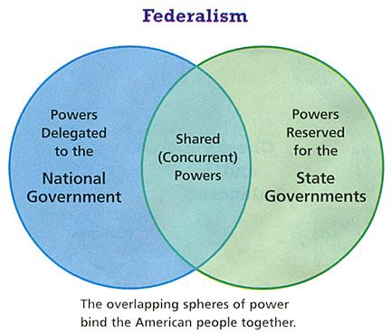

Slide 26
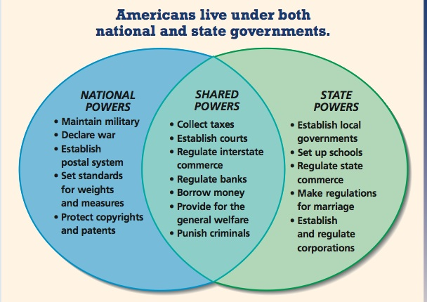

Slide 27
Andrew Jackson
McCulloch vs. Maryland
The state does NOT have the right to tax the federal government.

Slide 28
Andrew Jackson
Gibbons vs. Ogden
The Federal government has power over the states on commerce (business).

Slide 29
Andrew Jackson
Slave Import Act 1807
Slaves could no longer be brought in from another country.

Slide 30
Andrew Jackson
Gag Rule of 1836
Anti- Slavery petitions were forbidden in the House of Representatives.

Slide 31
Andrew Jackson
Henry Clay
“Great Compromiser’ Helped pass the Compromise Tariff of 1833. Lowered tariffs for 11 years.

